Slide 1
Meet SAP BusinessObjects, HMIS’s Reporting Tool
SAP BusinessObjects is a software program used to build and store the reports that help make HMIS data actionable
Notes:
SCRIPT
Hello! This presentation introduces SAP BusinessObjects, a software program used to build and store the reports that help make HMIS data actionable.
[Click to Transition to Next Slide]

Slide 2
This presentation uses animations. For the best learning experience, start the presentation’s slide show!
Notes:
This slide is included for PowerPoint viewers only: do not include it in recordings!

Slide 3
Presentation Contents
Welcome to BusinessObjects
Accessing BusinessObjects
The Home Screen: “BI Launch Pad”
User Settings
Hiding Unneeded Features
Selecting a Color Scheme
When In Doubt, Leave It Alone
Report Folders
Moving Between Folders
The SSA Report Gallery
Report Actions
Running Reports
View Now or Schedule for Later
Viewing a Report
Scheduling a Report
Prompts
Finding Your Reports
Instances
BI Inbox
Recently Run Reports
Additional Information
Timing Out
Refresh/Warehouse Build
Notes:
SCRIPT
This presentation contains the following sections:
Welcome to BusinessObjects explains how to access BusinessObjects from within HMIS and introduces the reporting tool’s home screen.
User Settings highlights settings that you can adjust to make BusinessObjects easier to use.
The Report Folders section explains how reports are organized into folders. It also covers common report actions a user might take.
Running Reports explains how to run a report immediately in View mode and how to schedule a report to complete at a later time.
In Finding Your Reports, you will learn where scheduled reports are saved.
Finally, Additional Information discusses important aspects of BusinessObjects that were not covered in the previous sections.
[Click to Transition to Next Slide]

Slide 4
Welcome to BusinessObjects
Notes:
SCRIPT
Welcome to BusinessObjects
[Click to Transition to Next Slide]

Slide 5
Accessing BusinessObjects
2A
Enter Data As
Back Date
Connect to BusinessObjects
1
There are three ways to open the reporting tool in HMIS:
Click on the Connect to BusinessObjects link found in the top right corner of the screen.
Click on the arrow next to Reports in the left side navigation menu. Then, select SAP BusinessObjects from the list of report options.
Click on Reports in the navigation menu to open the Report Dashboard. A link to SAP BusinessObjects can be found in the Custom Reports section.
3
2B
Notes:
SCRIPT
There are three ways to open the reporting tool in HMIS:
[Click to Play Animation]
Click on the Connect to BusinessObjects link found in the top right corner of the screen.
[Click to Play Animation]
Click on the arrow next to Reports in the left side navigation menu. Then, select SAP BusinessObjects from the list of report options.
[Click to Play Animation]
Click on Reports in the navigation menu to open the Report Dashboard. Then, choose SAP BusinessObjects from the list of Custom Report options.
[Click to Transition to Next Slide]

Slide 6
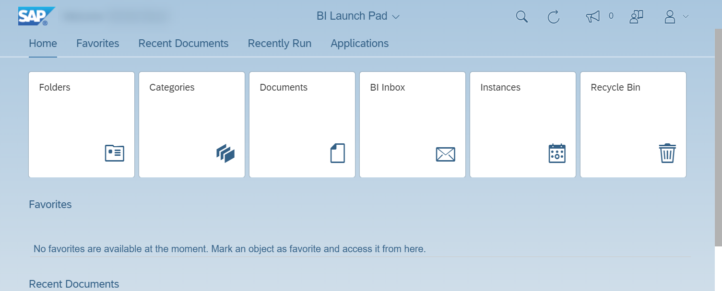
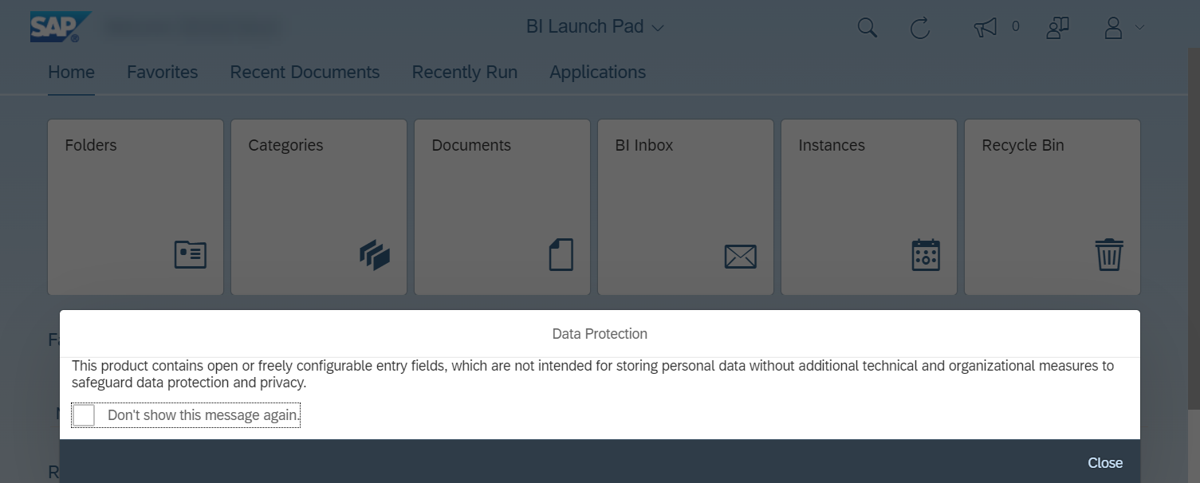
The Home Screen: “BI Launch Pad”
The first time you open BusinessObjects, a Data Protection popup will appear. Selecting Don’t show this message again before closing the popup will prevent it from appearing again.
After closing the popup, you will see the BI, or “Business Intelligence” Launch Pad. From this home screen, you can look for a report to run, review saved reports, and update your user account settings.
Notes:
SCRIPT
The first time you open BusinessObjects, a Data Protection popup will appear. Selecting Don’t show this message again before closing the popup will prevent it from appearing again.
[Click to Play Animation]
After closing the popup, you will see the BI, or “Business Intelligence” Launch Pad. From this home screen, you can look for a report to run, review saved reports, and update your user account settings.
[Click to Transition to Next Slide]

Slide 7
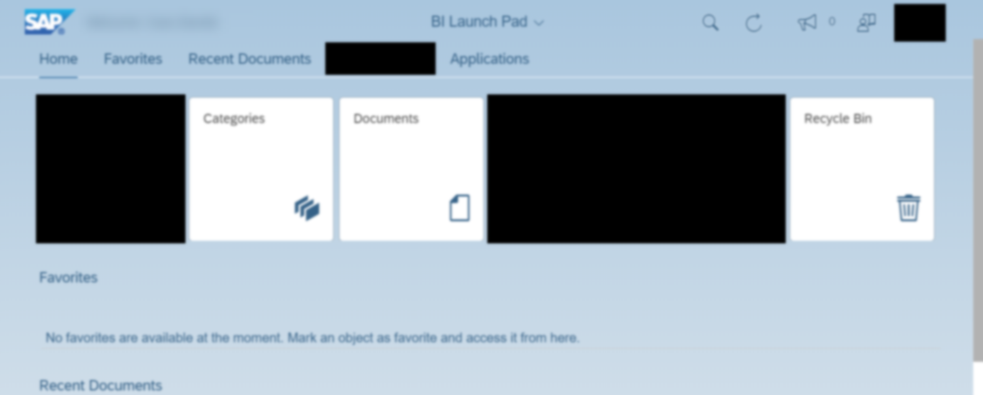
The Home Screen: “BI Launch Pad”
The number of options on the home screen can be overwhelming. Thankfully, you only need to care about these features:
Folders, BI Inbox, Instances, Recently Run, and User Settings
For the best user experience, ICA recommends that you hide unneeded features. Let’s see how to do that next!
Notes:
SCRIPT
The number of options on the home screen can be overwhelming. Thankfully, you only need to care about these features:
[Click to Play Animation]
Folders, BI Inbox, Instances, Recently Run, and User Settings
[Click to Play Animation]
For the best user experience, ICA recommends that you hide unneeded features. Let’s see how to do that next!
[Click to Transition to Next Slide]

Slide 8
User Settings
Notes:
SCRIPT
User settings.
[Click to Transition to Next Slide]

Slide 9
User Settings:
Hiding Unneeded Features
Notes:
SCRIPT
Hiding unneeded features.
[Click to Transition to Next Slide]

Slide 10
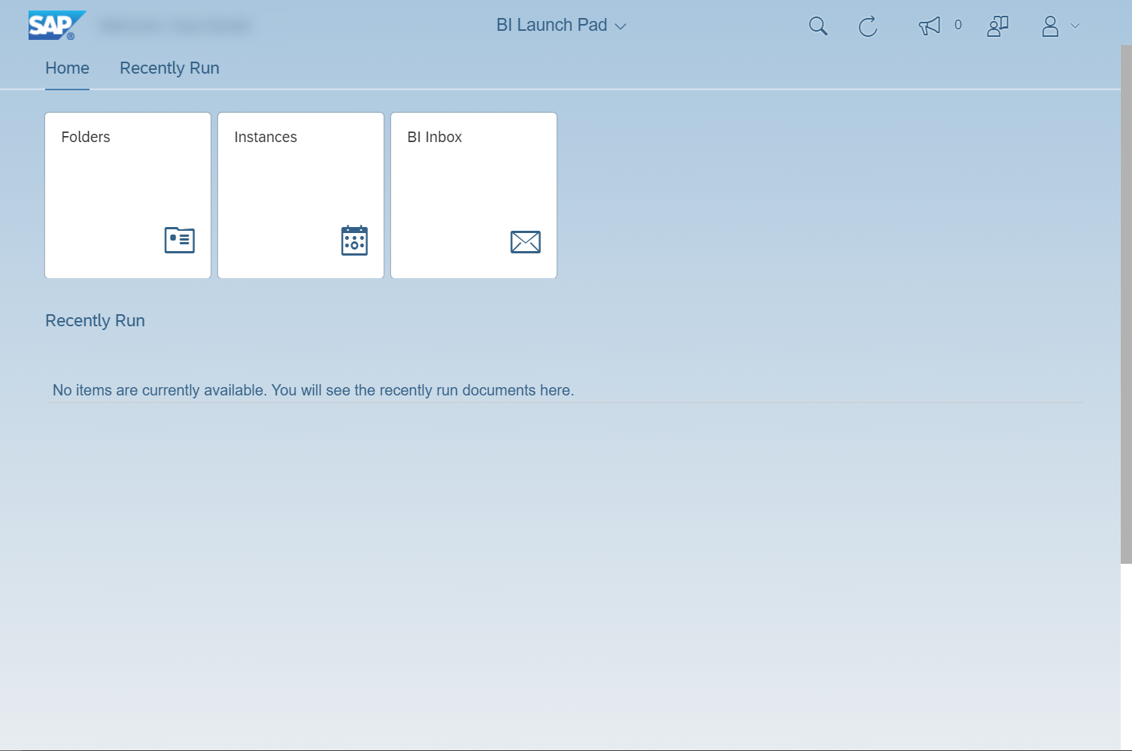
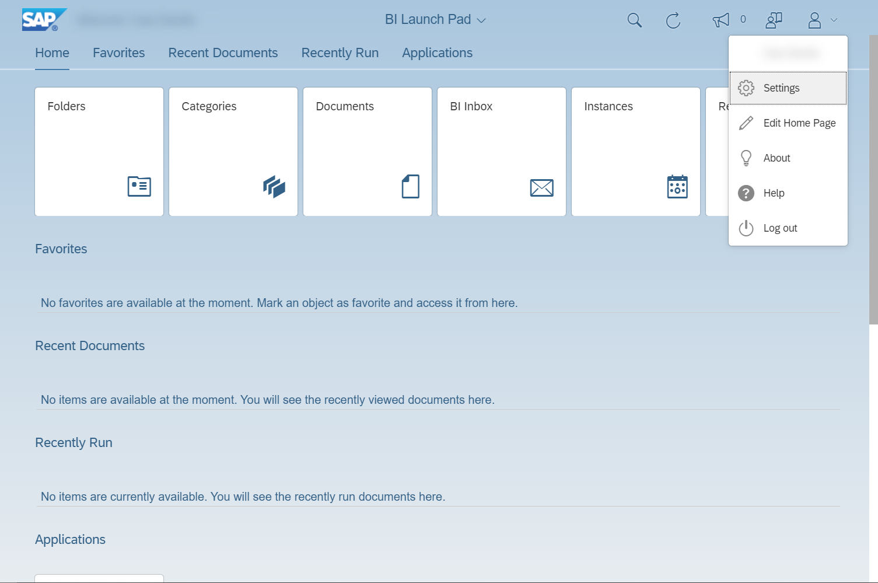
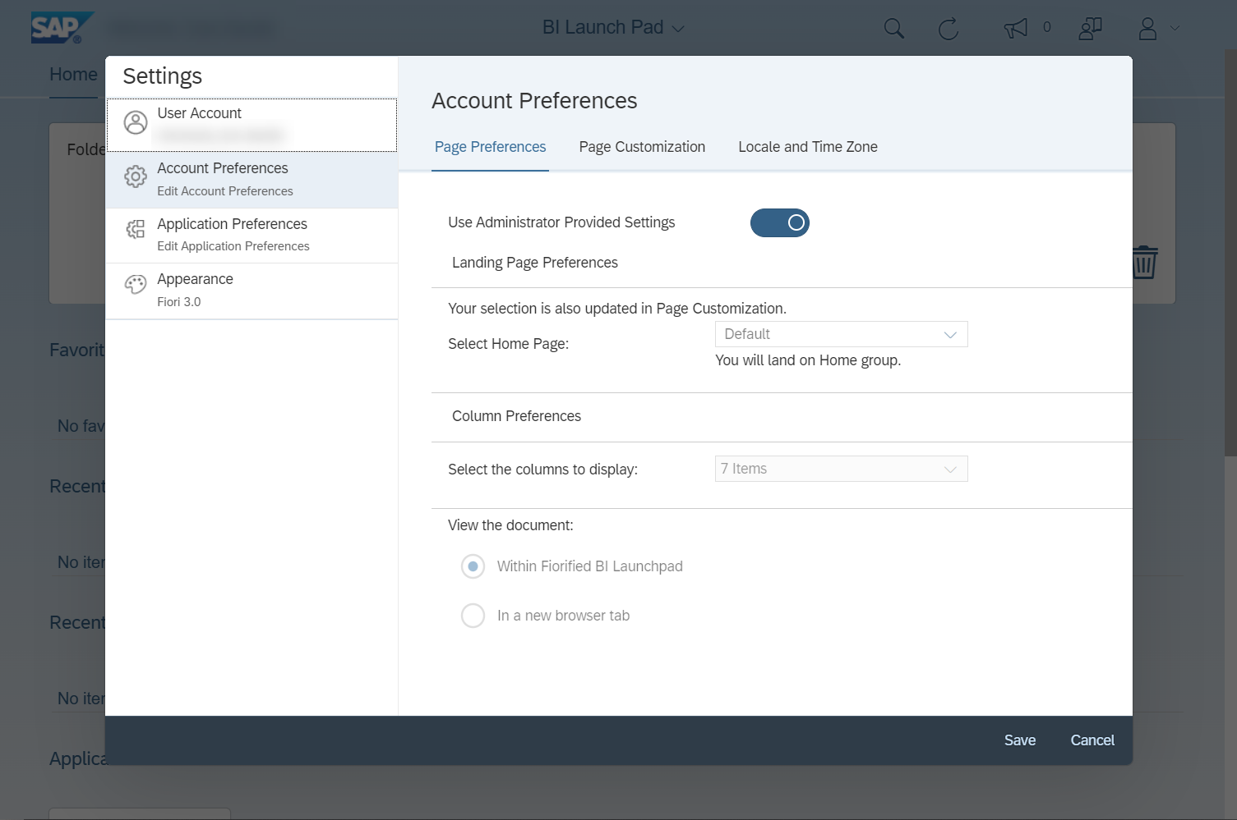
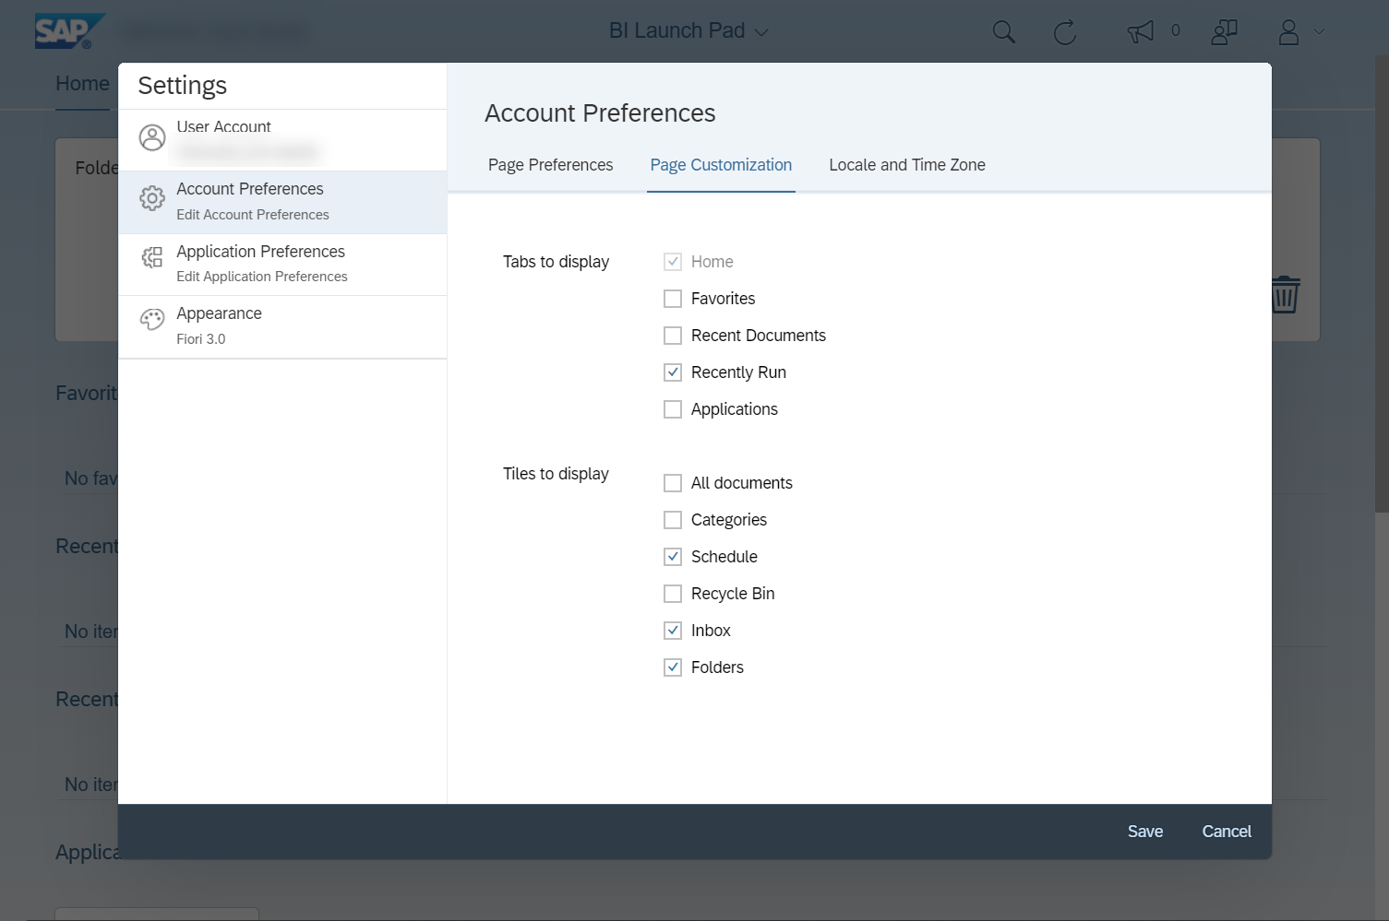
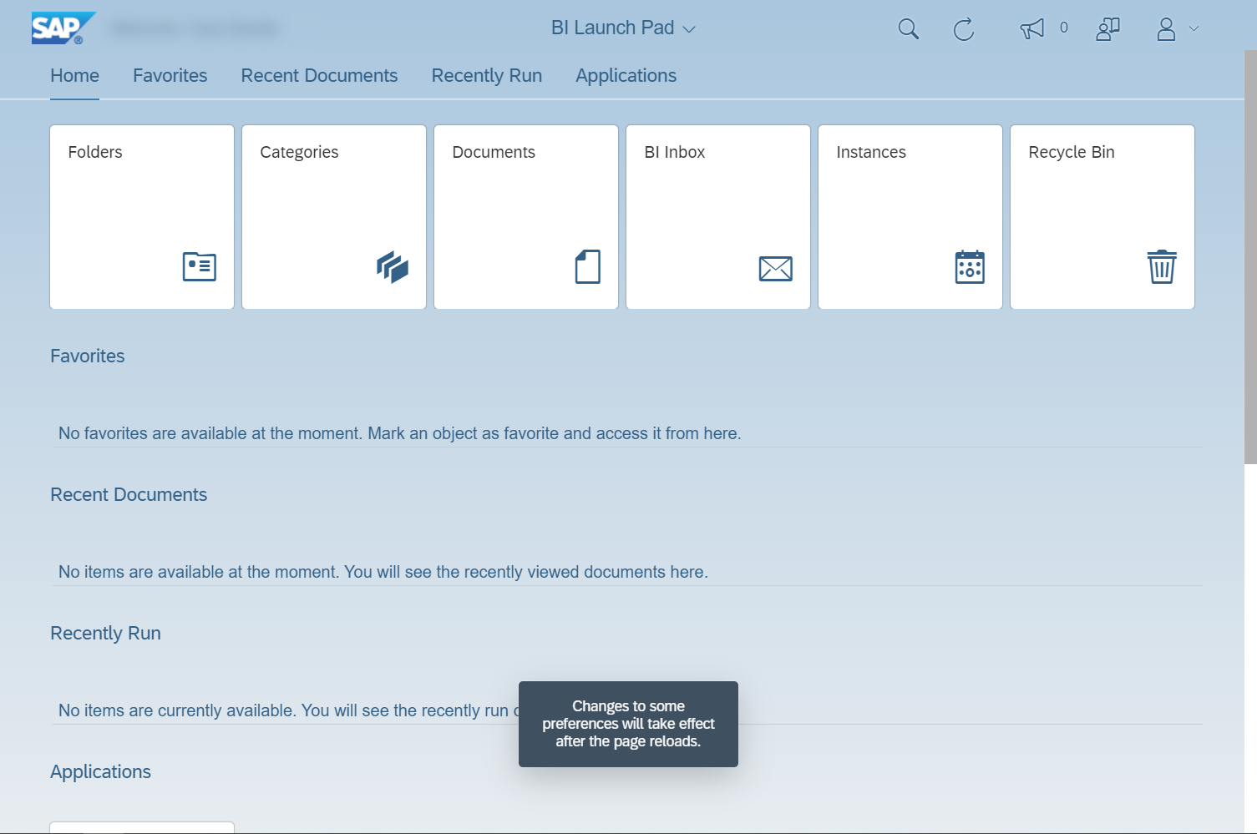
Click on Save to close the popup window and apply your changes.
Back on the home screen, a message will appear asking you to exit and reopen the reporting tool.
1
2
5
3
4
6
8
7
To customize the home screen, you will need to first click on the user icon.
From the user menu that appears, choose Settings.
In the Settings popup window, make sure that Account Preferences is selected.
Click on the Use Administrator Provided Settings slider to unlock the ability to customize your settings. You will know the slider is in the correct position if you can change the setting Select Home Page, which you will find right below the slider.
Select Page Customization to find a list of features you can choose to show or hide.
Uncheck the box next to Favorites, Recent Documents, Applications, All Documents, Categories, and Recycle Bin. There should be five boxes checked when you are finished.
Following those instructions will apply your new settings, presenting you with a much tidier home screen!
Notes:
SCRIPT
To customize the home screen, you will need to first click on the user icon.
[Click to Play Animation]
From the user menu that appears, choose Settings.
[Click to Play Animation]
In the Settings popup window, make sure that Account Preferences is selected.
[Click to Play Animation]
Click on the Use Administrator Provided Settings slider to unlock the ability to customize your settings. You will know the slider is in the correct position if you can change the setting Select Home Page, which you will find right below the slider. [Click to Play Animation]
Select Page Customization to find a list of features you can choose to show or hide.
[Click to Play Animation]
Uncheck the box next to Favorites, Recent Documents, Applications, All Documents, Categories, and Recycle Bin. There should be five boxes checked when you are finished.
[Click to Play Animation]
Click on Save to close the popup window and apply your changes.
[Click to Play Animation]
Back on the home screen, a message will appear asking you to exit and reopen the reporting tool.
[Click to Play Animation]
Following those instructions will apply your new settings, presenting you with a much tidier home screen!
[Click to Transition to Next Slide]

Slide 11
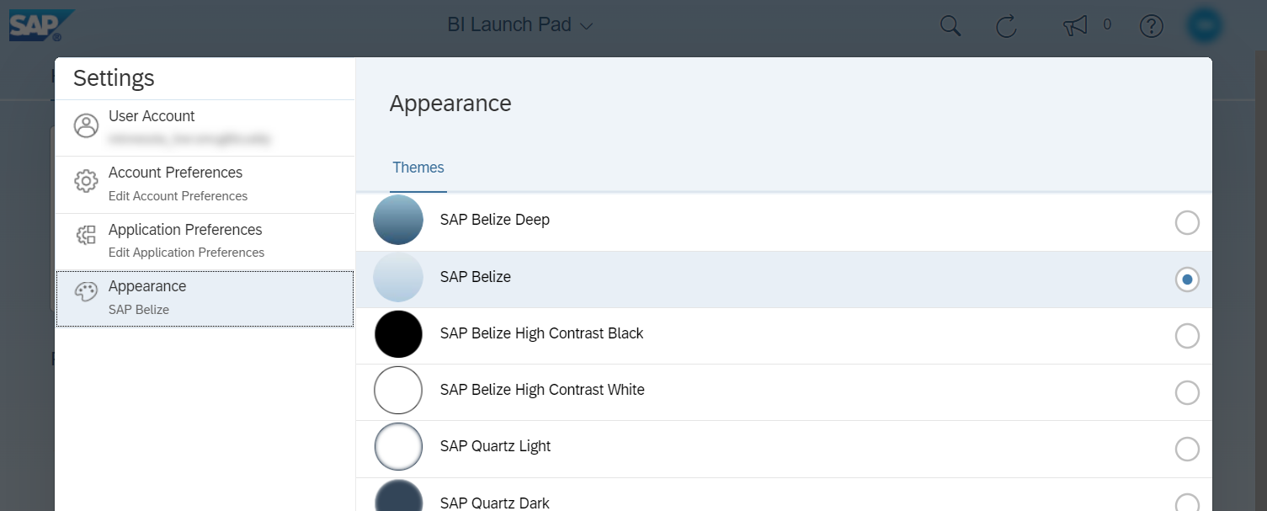
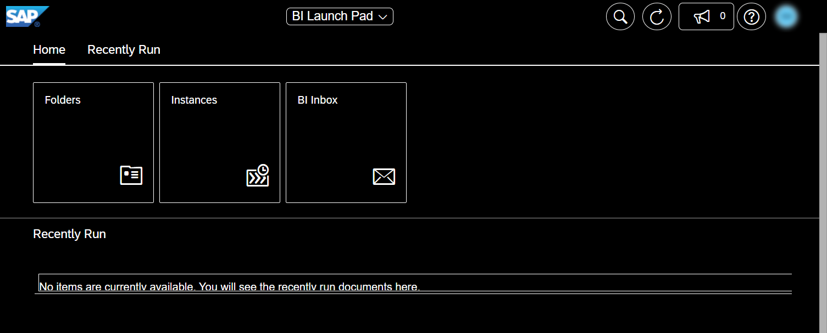
User Settings: Selecting a Color Scheme
In addition to hiding unneeded features, you may also want to adjust the reporting tool’s colors by picking a different theme. In the Appearance menu, you will find a drop-down menu containing multiple theme options.
Selecting a high-contrast theme can make it easier to read text and move around in BusinessObjects.
Notes:
SCRIPT
In addition to hiding unneeded features, you may also want to adjust the reporting tool’s colors by picking a different theme. In the Appearance menu, you will find a drop-down menu containing multiple theme options.
[Click to Play Animation]
Selecting a high-contrast theme can make it easier to read text and move around in BusinessObjects.
[Click to Transition to Next Slide]

Slide 12
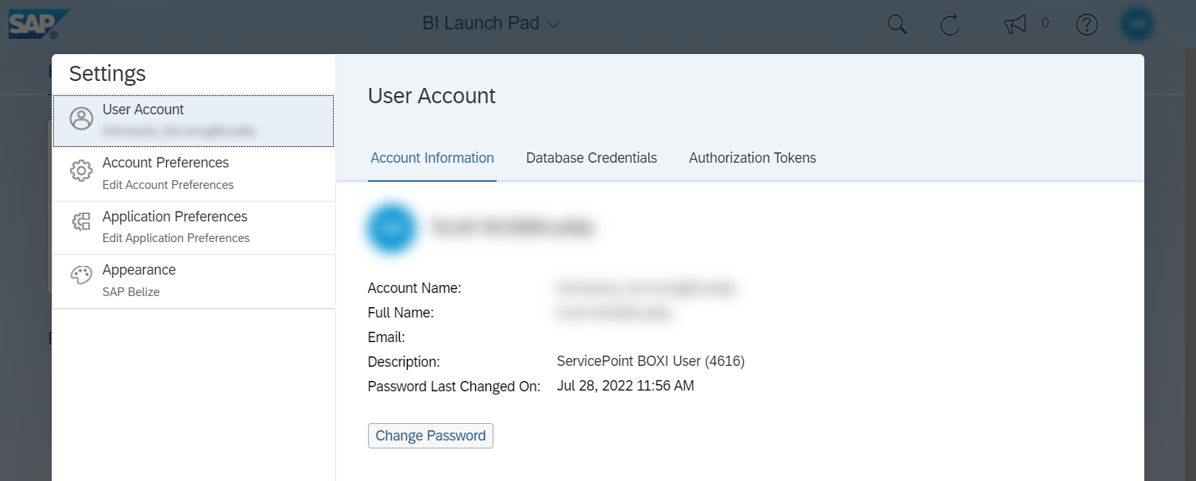
User Settings: When In Doubt, Leave It Alone
Unless ICA encourages you to change a specific user setting, it should be left alone. Altering certain settings could cause your reports to return incomplete or inaccurate information.
This advice extends even to the Change Password feature: Entering a new password there will not actually change your password!
Notes:
SCRIPT
Unless ICA encourages you to change a specific user setting, it should be left alone. Altering certain settings could cause your reports to return incomplete or inaccurate information.
[Click to Play Animation]
This advice extends even to the Change Password feature: Entering a new password there will not actually change your password!
[Click to Transition to Next Slide]

Slide 13
Report Folders
Notes:
SCRIPT
Report folders.
[Click to Transition to Next Slide]

Slide 14
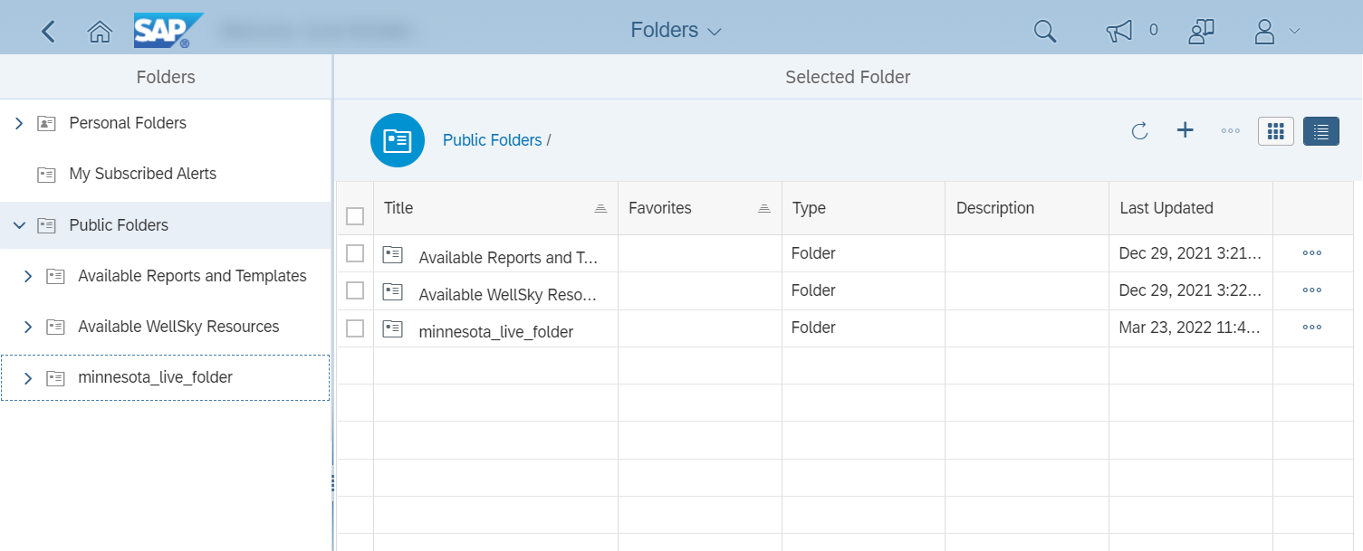
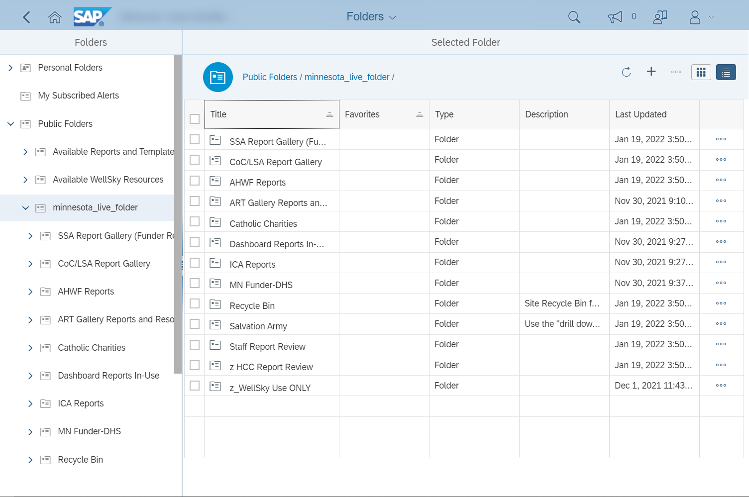
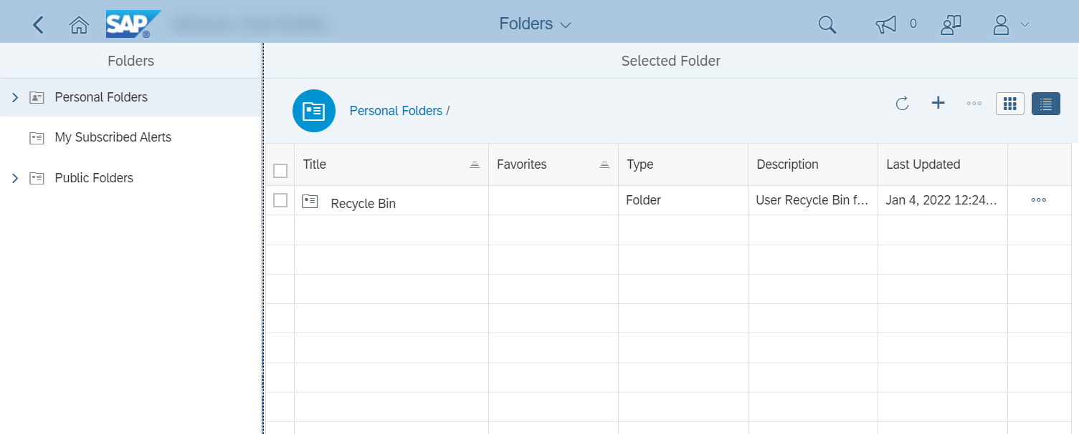
Report Folders: Moving Between Folders
Breadcrumb Trail
Navigation Menu
Content Pane
When you are ready to run a report, select the Folders option from the home screen.
The first folder you will see is your Personal Folder.
Because users’ personal folders do not hold any reports, your immediate next step will be to choose Public Folders from the navigation menu on the left side of the screen.
When you click on a folder in the navigation menu, its subfolders will appear.
Those same subfolders will also appear in the content pane.
As you open folders, they will be added to the breadcrumb trail. Jump to a folder by clicking on its name in the breadcrumb trail.
To return to the home screen, you can click either the Back button or the Home button.
Notes:
SCRIPT
When you are ready to run a report, select the Folders option from the home screen.
[Click to Play Animation]
The first folder you will see is your Personal Folder.
[Click to Play Animation]
Because users’ personal folders do not hold any reports, your immediate next step will be to choose Public Folders from the navigation menu on the left side of the screen.
[Click to Play Animation]
When you click on a folder in the navigation menu, its subfolders will appear.
[Click to Play Animation]
Those same subfolders will also appear in the content pane.
[Click to Play Animation]
As you open additional folders, they will be added to the breadcrumb trail. Clicking on a folder’s name in the breadcrumb trail will jump to that folder.
[Click to Play Animation]
To return to the home screen, you can click either the Back button or the Home button.
[Click to Transition to Next Slide]

Slide 15
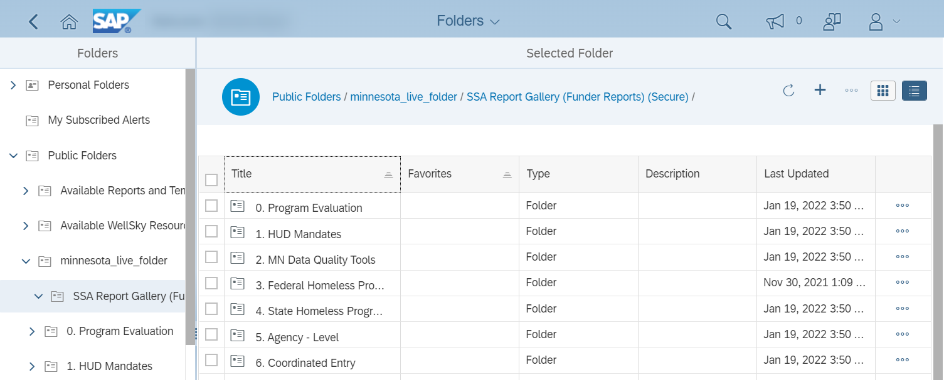
Report Folders: The SSA Report Gallery
In the minnesota_live folder, some users will find subfolders that have been created specifically for their agencies; most users, however, will want to open the SSA Report Gallery folder to locate the reports they need.
The folders in the SSA Report Gallery hold reports developed for a variety of purposes, like sharing information with federal and state funders, reviewing data quality, and managing Coordinated Entry systems.
Notes:
SCRIPT
In the minnesota_live folder, some users will find subfolders that have been created specifically for their agencies; most users, however, will want to open the SSA Report Gallery folder to locate the reports they need.
[Click to Play Animation]
The folders in the SSA Report Gallery hold reports developed for a variety of purposes, like sharing information with federal and state funders, reviewing data quality, and managing Coordinated Entry systems.
[Click to Transition to Next Slide]

Slide 16
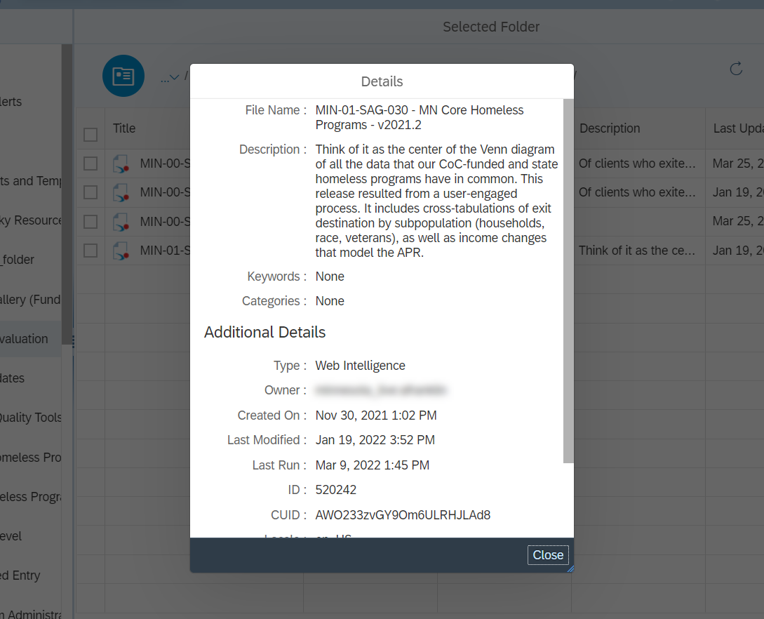
Report Folders: Actions
Click on the Actions icon to see a list of available report actions. Right-clicking on a report will also bring up the actions menu.
ICA recommends taking only the following actions:
View and Schedule are used to run reports. We’ll take an in-depth look at those actions in another section.
If you have scheduled a report previously, selecting History will display past report “instances”, or saved copies.
Details will display additional information about a report.
Notes:
SCRIPT
Click on the Actions icon to see a list of available report actions. Right-clicking on a report will also bring up the actions menu.
[Click to Play Animation]
ICA recommends taking only the following actions:
[Click to Play Animation]
View and Schedule are used to run reports. We’ll take an in-depth look at those actions in another section.
[Click to Play Animation]
If you have scheduled a report previously, selecting History will display past report “instances”, or saved copies.
[Click to Play Animation]
Details will display additional information about a report.
[Click to Transition to Next Slide]

Slide 17
Running Reports
Notes:
SCRIPT
Running reports.

Slide 18
Running Reports: View Now or Schedule for Later
View
Schedule
When you have found the report you want to run, you can choose to View or Schedule it:
Clicking on the name of the report will open it in View mode. This mode lets you run a report immediately.
Selecting the Schedule option from the actions menu lets you schedule a report to run at a chosen time. You can open the actions menu by clicking on its icon or by right-clicking on a report.
Notes:
SCRIPT
When you have found the report you want to run, you can choose to View or Schedule it:
[Click to Play Animation]
Clicking on the name of the report will open it in View mode. This mode lets you run a report immediately.
[Click to Play Animation]
Selecting the Schedule option from the actions menu lets you schedule a report to run at a chosen time. You can open the actions menu by clicking on its icon or by right-clicking on a report.
[Click to Transition to Next Slide]

Slide 19
Running Reports:
Viewing a Report
Notes:
SCRIPT
Viewing a report.
[Click to Transition to Next Slide]

Slide 20
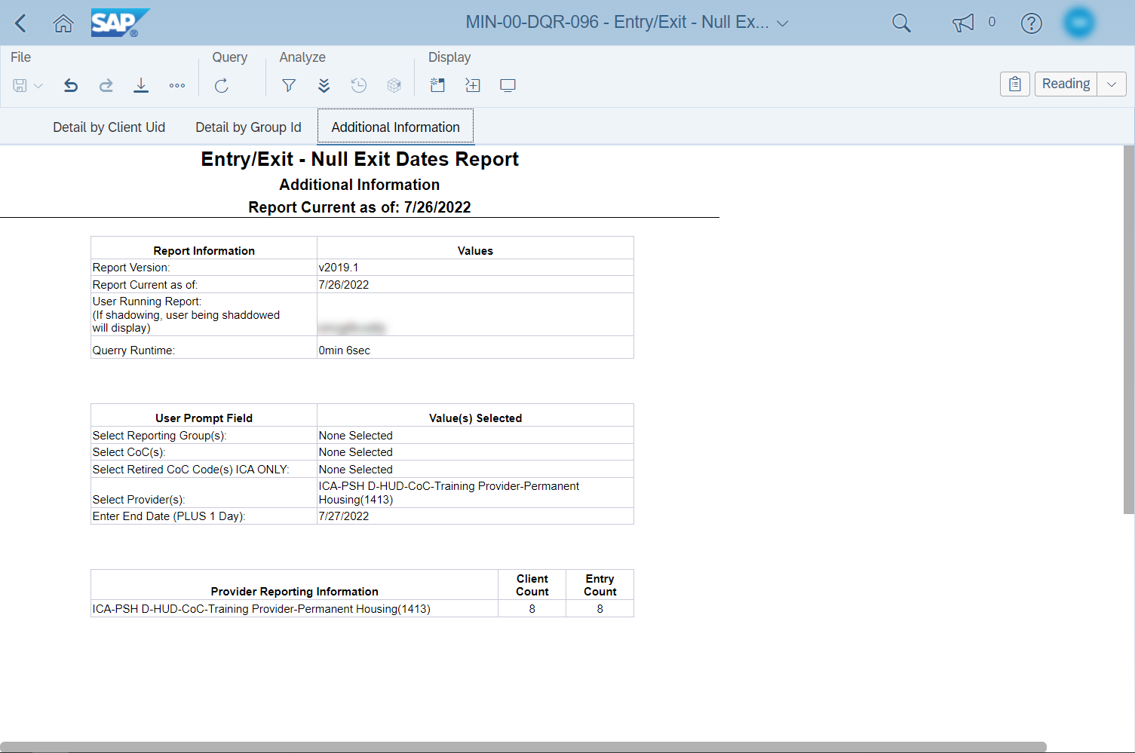
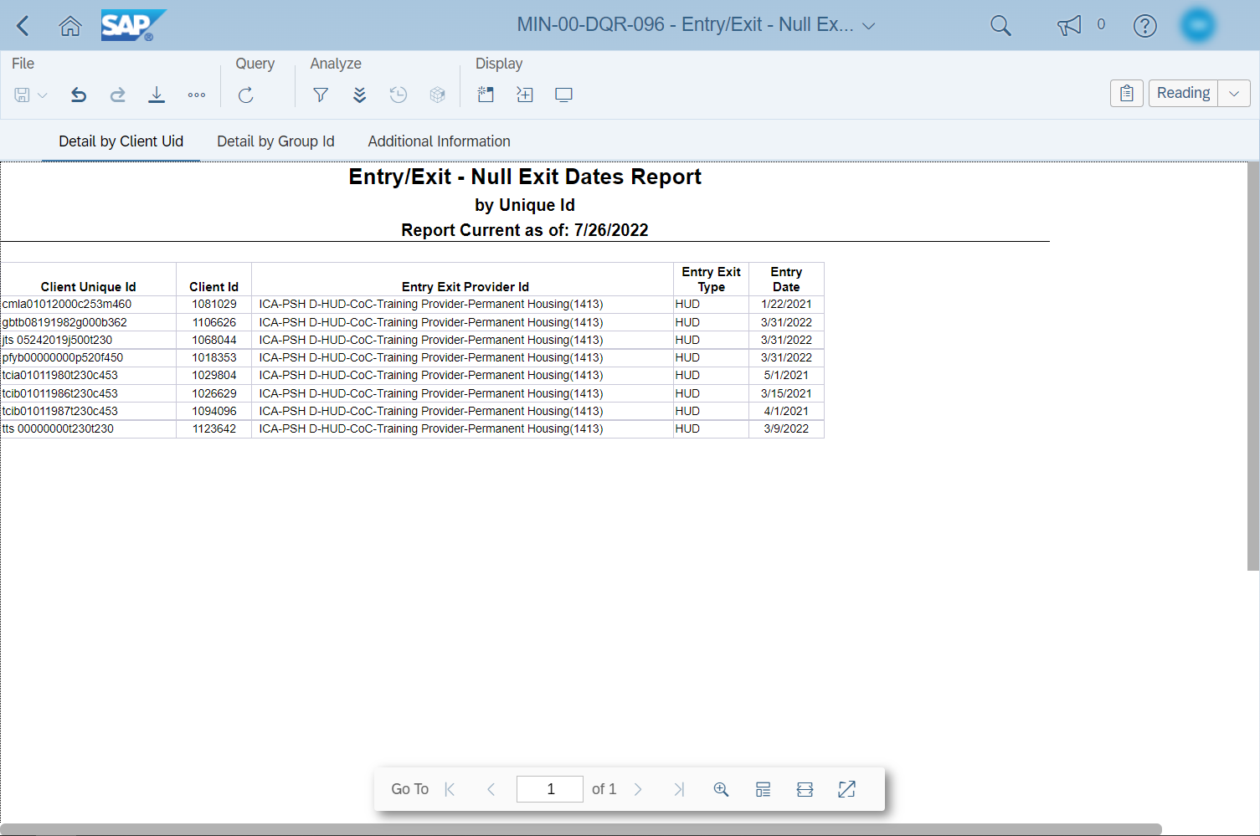
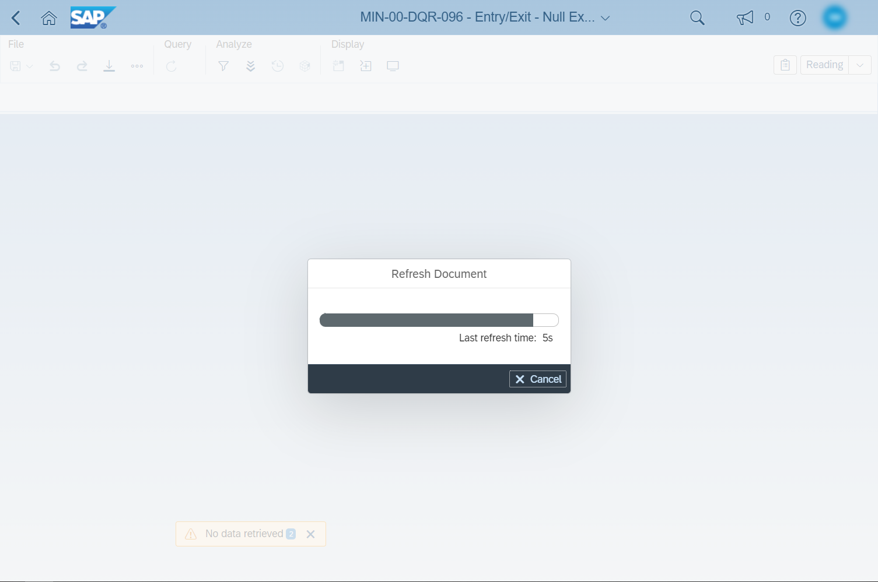
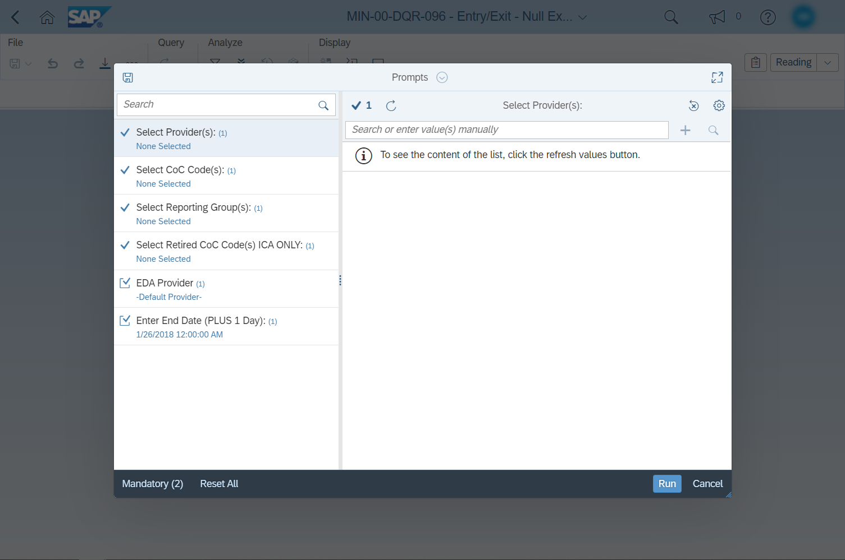
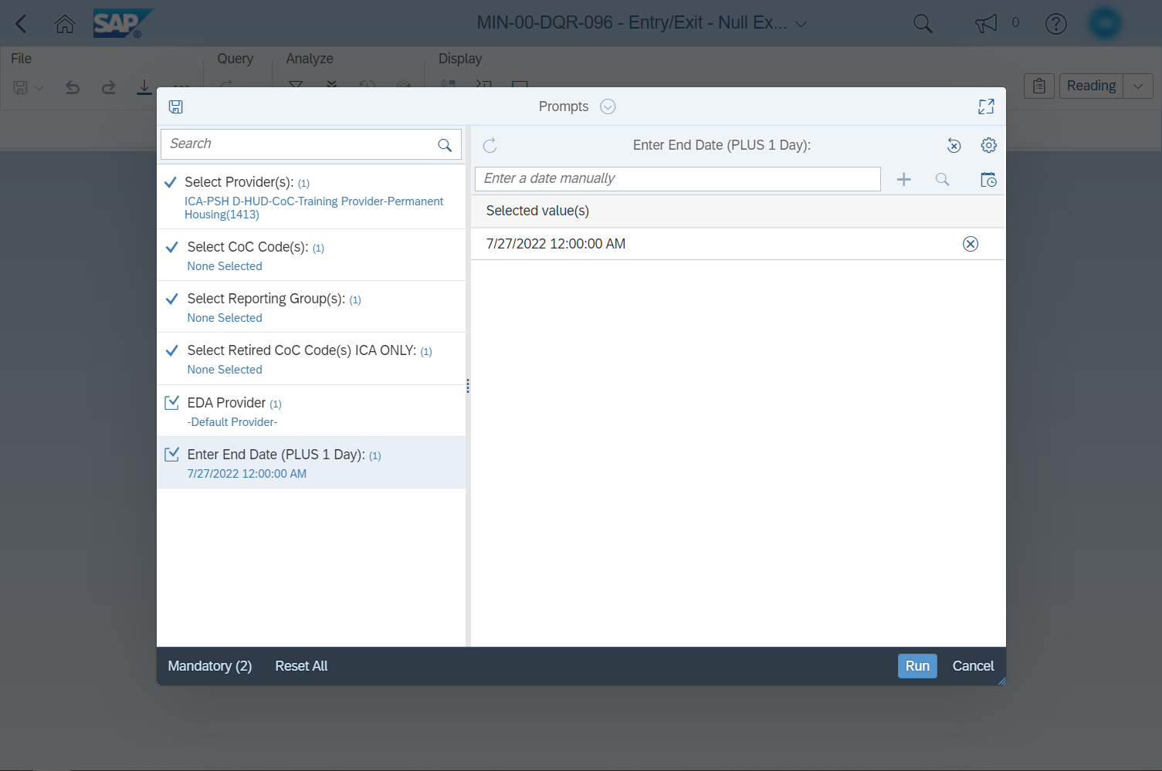
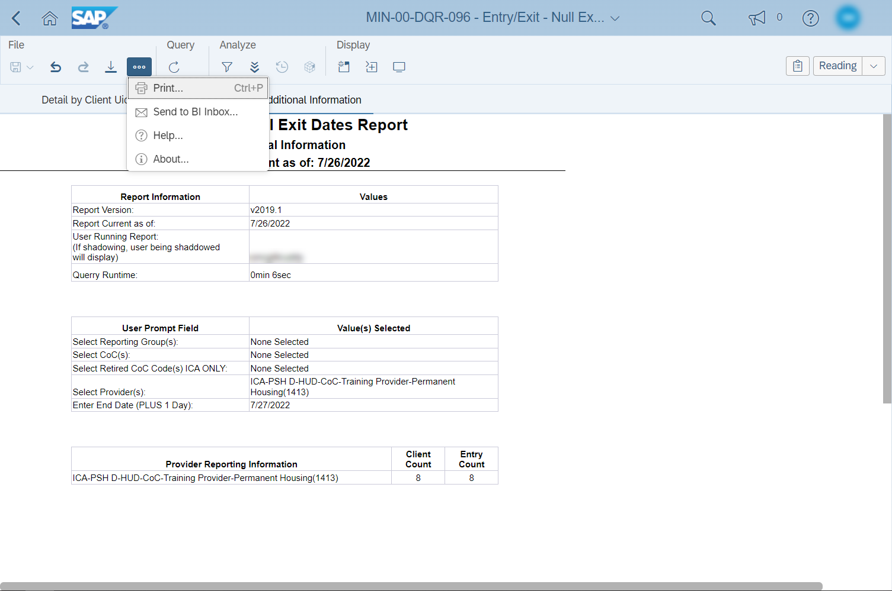
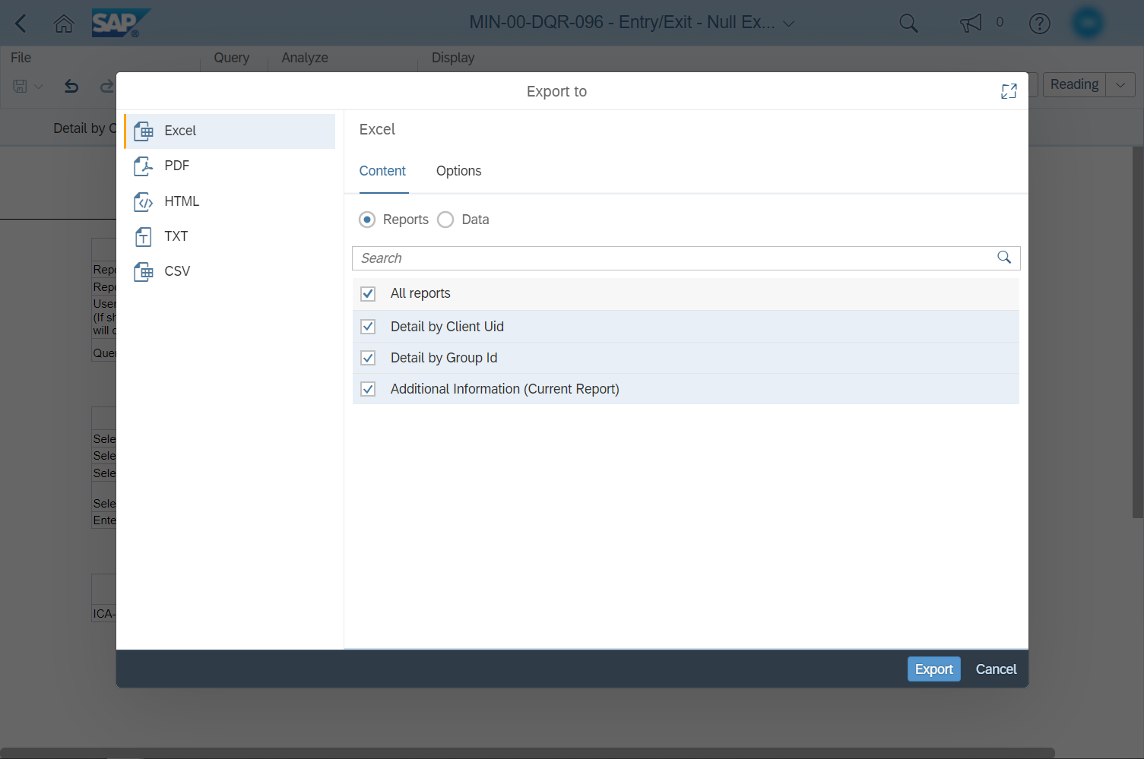
If you have opened a report in View mode, the first thing that you will see is the Refresh Document popup.
The Prompts popup will appear once the document has finished loading. The selections you make here will determine what data gets pulled into your report.
When the desired prompt selections have been made, click on the Run button.
The refresh popup will appear again, tracking the progress of the report as it loads data.
When the report has finished loading, it will be displayed on the screen.
Moving your mouse over the report will cause a Navigation Menu to appear.
The left side of the menu is used to switch between pages of data.
The right side includes options for changing the reports’ display, like zoom and full screen mode.
Selecting a different report tab will display the data found in that section of the report.
1
2
3
When you are ready to save a copy of the report, do not click on the Save icon.
Instead, to print the report, click on the Actions icon and select Print.
To download a report, click on the Export icon.
Selecting Export will cause a new popup window to appear.
Choose the file type (1) and which report tabs to include (2), then click on Export (3). Your report will be downloaded to your computer.
Notes:
SCRIPT
If you have opened a report in View mode, the first thing that you will see is the Refresh Document popup.
[Click to Play Animation]
The Prompts popup will appear once the document has finished loading. The selections you make here will determine what data gets pulled into your report.
[Click to Play Animation]
When the desired prompt selections have been made, click on the Run button.
[Click to Play Animation]
The refresh popup will appear again, tracking the progress of the report as it loads data.
[Click to Play Animation]
When the report has finished loading, it will be displayed on the screen.
[Click to Play Animation]
Moving your mouse over the report will cause a Navigation Menu to appear.
[Click to Play Animation]
The left side of the menu is used to switch between pages of data.
[Click to Play Animation]
The right side includes options for changing the reports’ display, like zoom and full screen mode.
[Click to Play Animation]
Selecting a different report tab will display the data found in that section of the report.
[Click to Play Animation]
When you are ready to save a copy of the report, do not click on the Save icon.
[Click to Play Animation]
Instead, to print the report, click on the Actions icon and select Print.
[Click to Play Animation]
To download a report, click on the Export icon.
[Click to Play Animation]
Selecting Export will cause a new popup window to appear.
[Click to Play Animation]
Choose the file type (1) and which report tabs to include (2), then click on Export (3). Your report will be downloaded to your computer.
[Click to Transition to Next Slide]

Slide 21
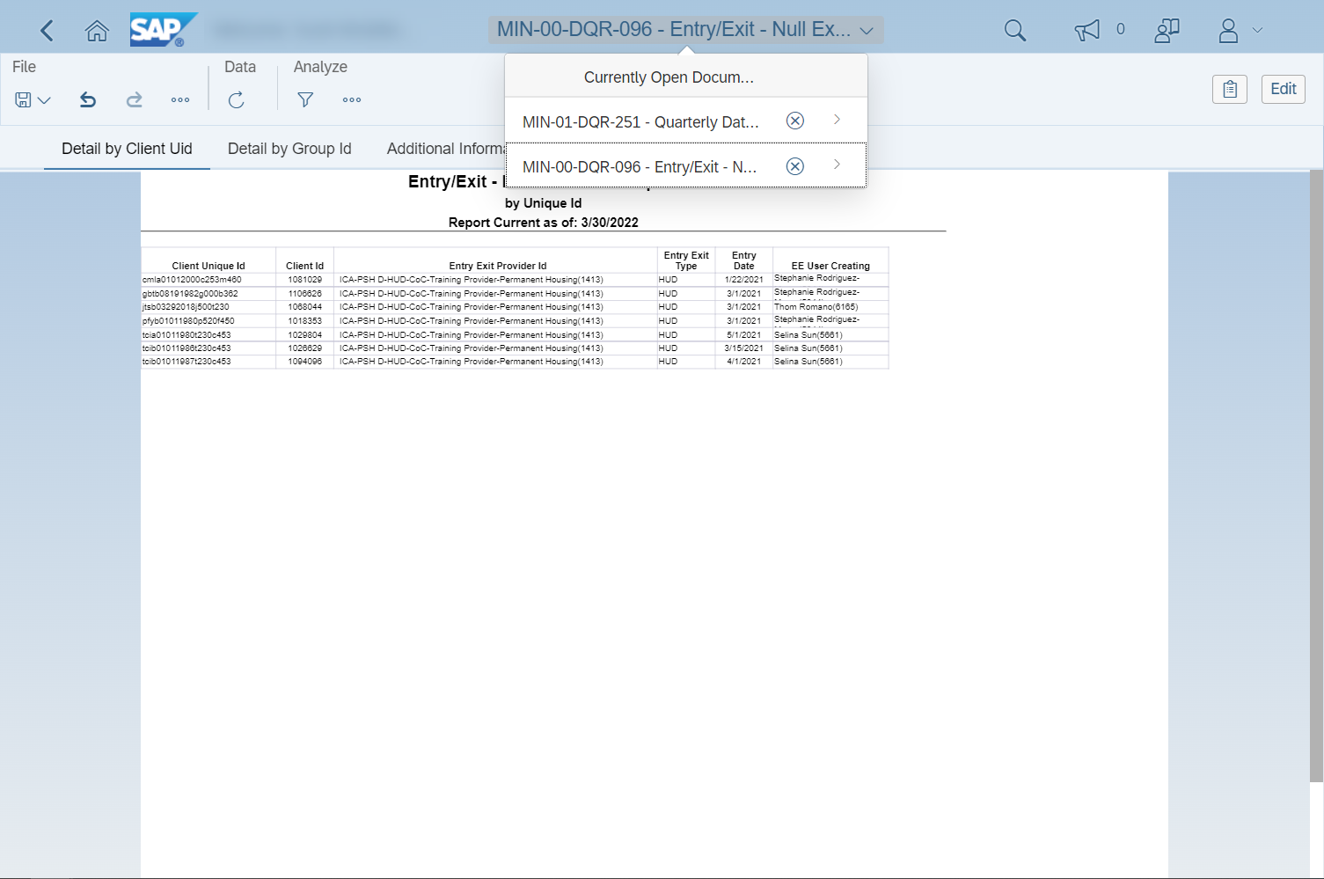
You can have multiple reports open in View mode. To see which reports are currently open, click on the Document Switcher at the top of the screen.
Clicking on the name of a report will open it.
To close a report, click on the close button.
Notes:
SCRIPT
You can have multiple reports open in View mode. To see which reports are currently open, click on the Document Switcher at the top of the screen.
[Click to Play Animation]
Clicking on the name of a report will open it.
[Click to Play Animation]
To close a report, click on the close button.
[Click to Transition to Next Slide]

Slide 22
Running Reports:
Scheduling a Report
Notes:
SCRIPT
Scheduling a report.
[Click to Transition to Next Slide]

Slide 23
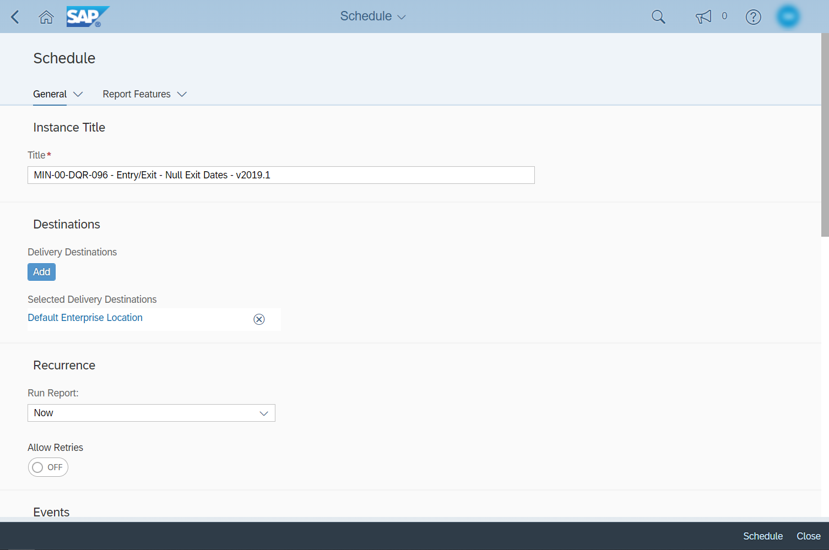
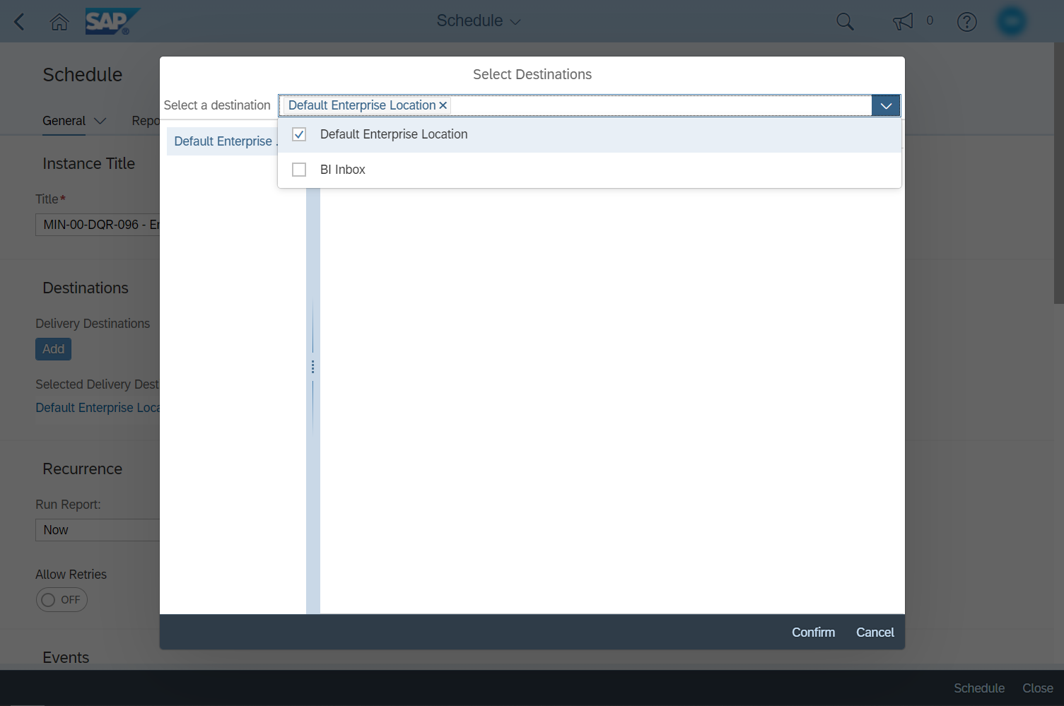
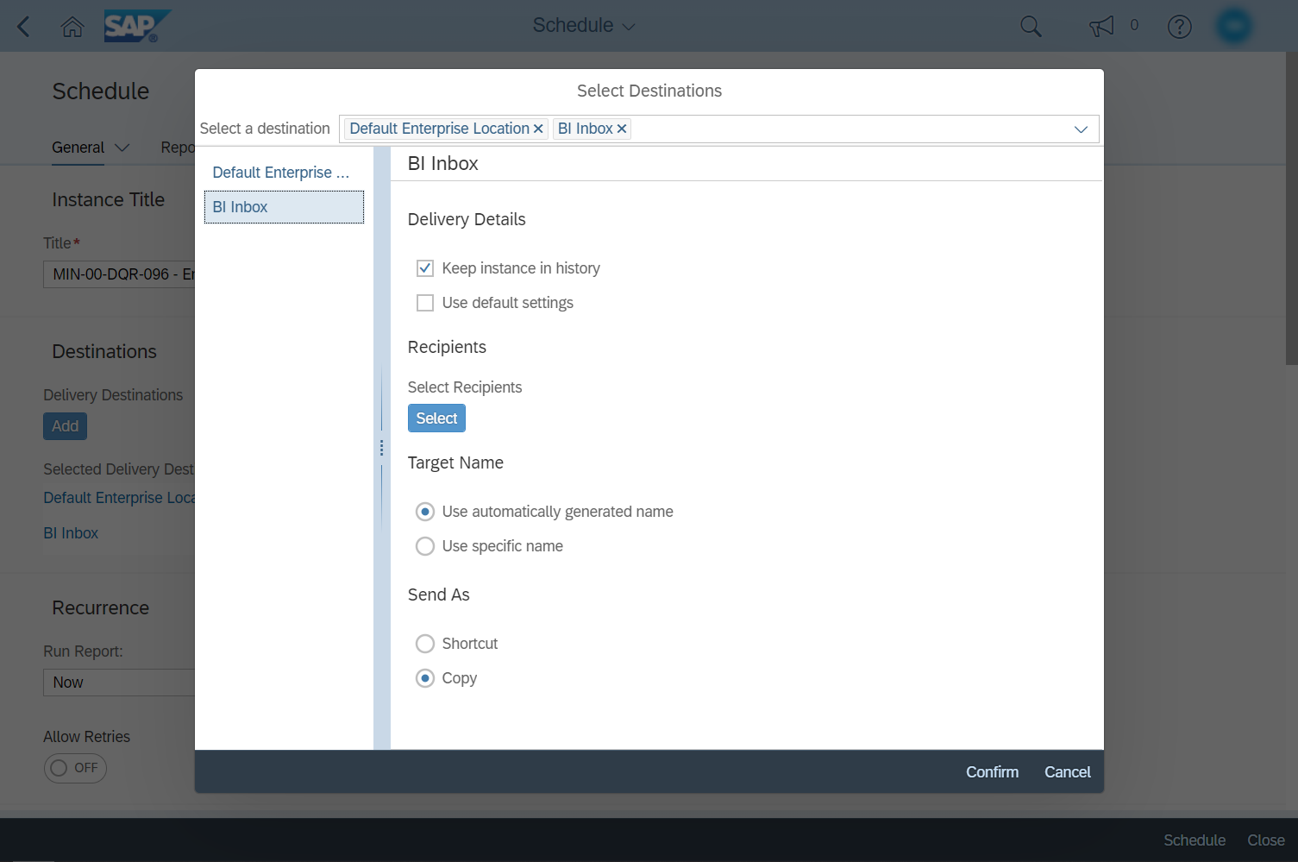
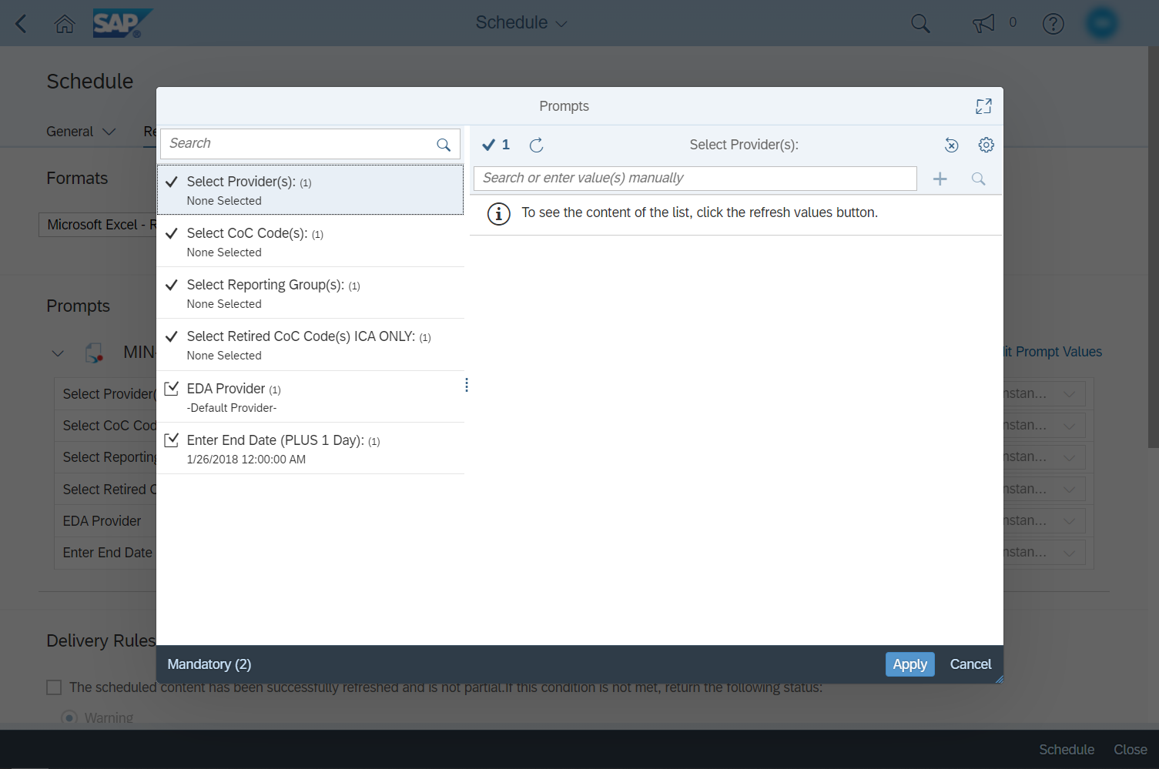
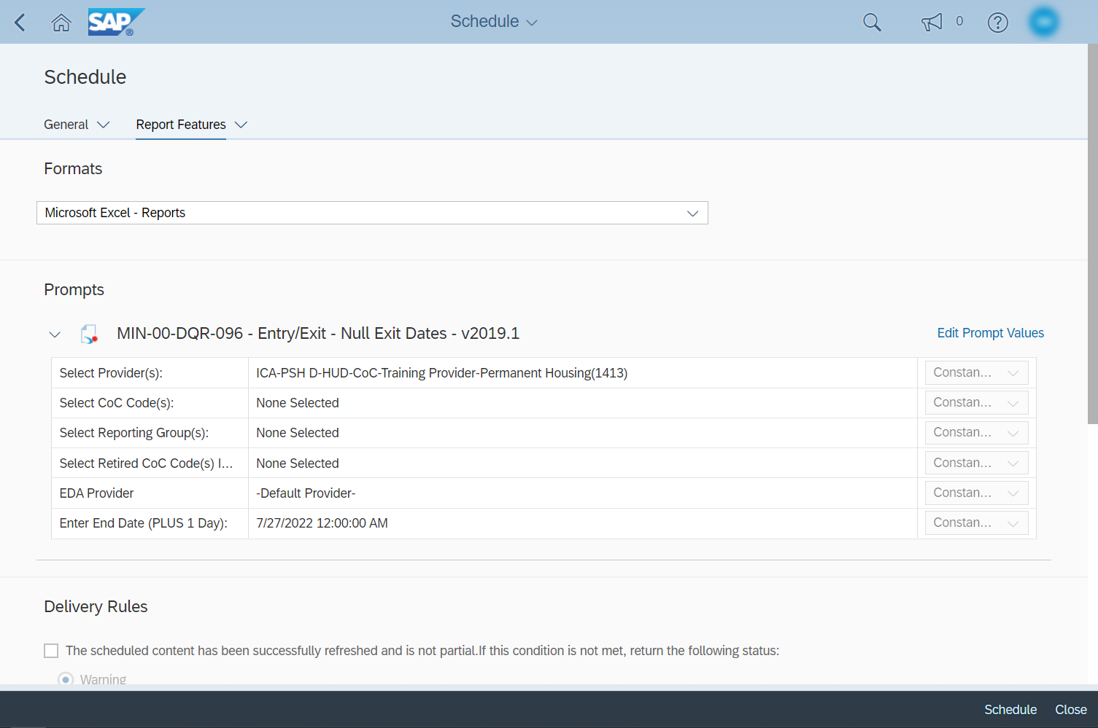
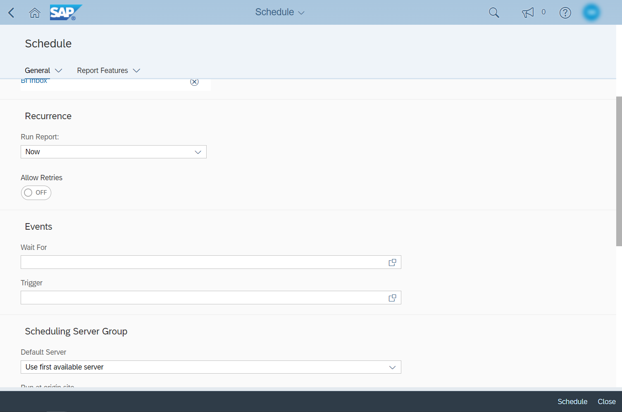
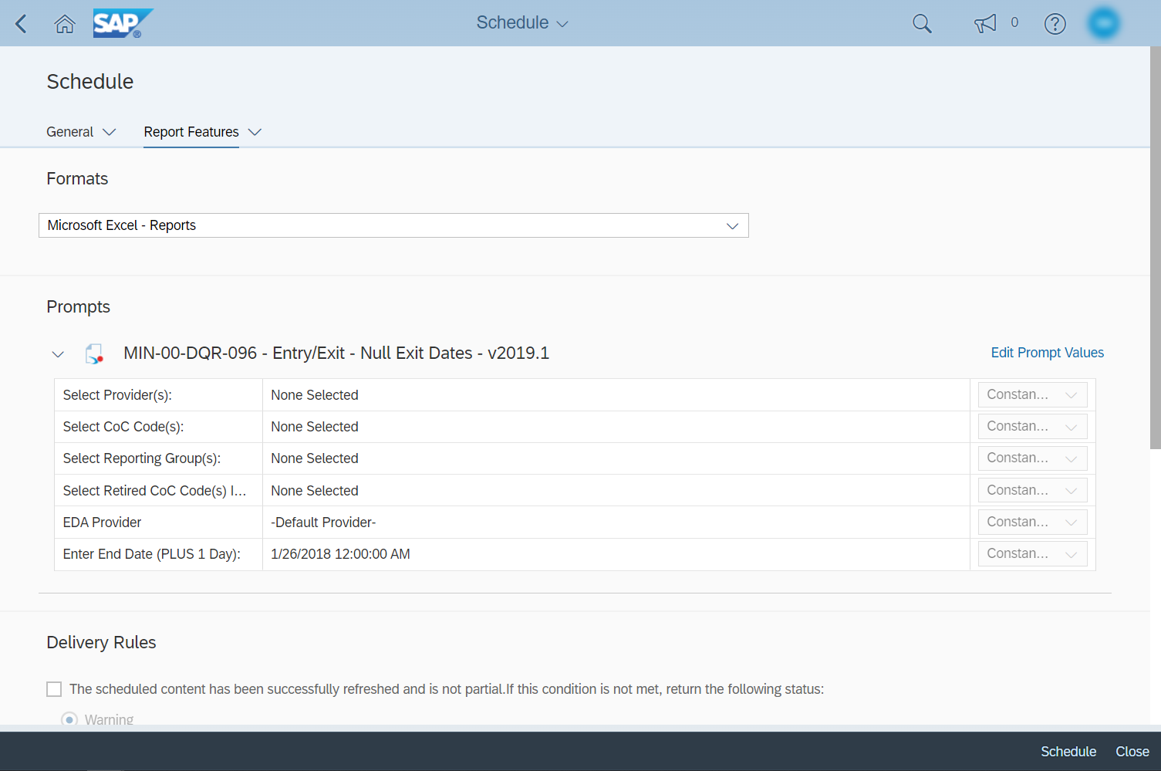
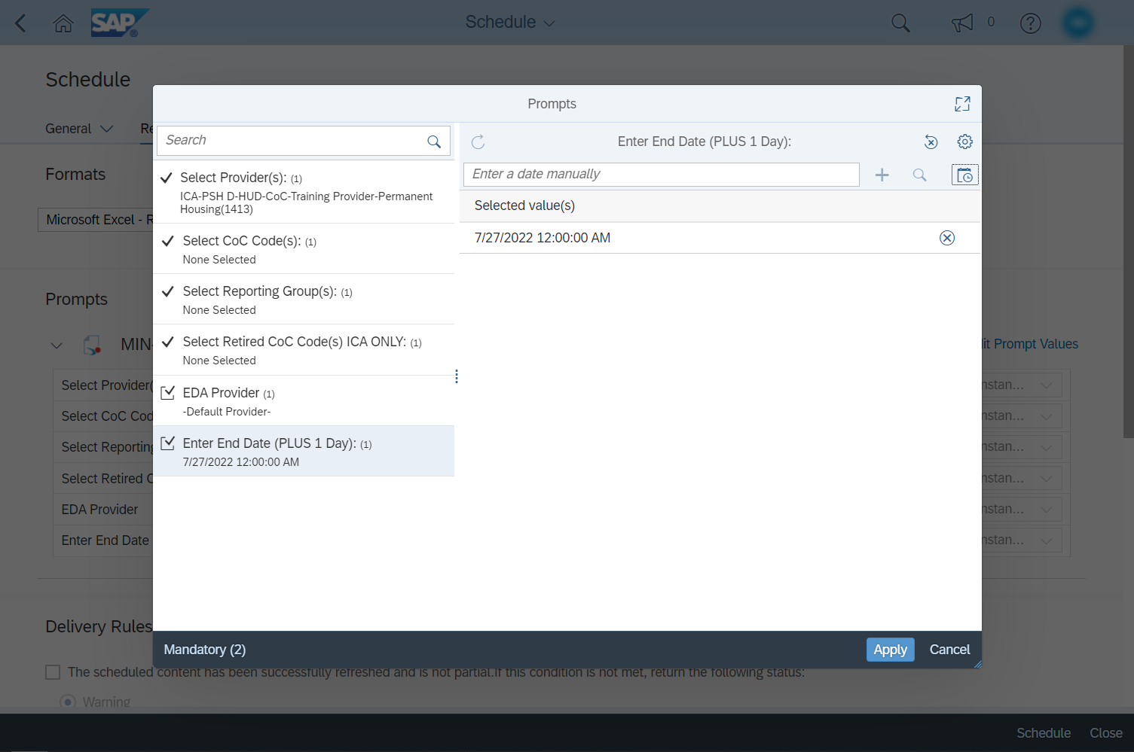
Click on Confirm to close the popup window.
When you have completed all necessary prompts, click on Apply. You can also click on Cancel if you wish to clear the prompt selections you made and return to the Schedule screen.
The final step is to click on the Schedule button. You can ignore the Delivery Rules settings.
3
7
10
4
8
1
6
9
2
11
5
If you have chosen to schedule a report, you will be taken to the Schedule screen. On that screen, you will need to make several selections.
First, decide what to call your report. By default, the title will match the report’s name.
The default delivery destination is your Instances folder. Optionally, you can choose to save a copy in your BI Inbox as well. Click on Add to specify a new delivery destination.
In the Select Destinations popup window, click on the blue arrow to expand the list of available destinations. You can also search for options by typing in the Select a destination field.
Check the box next to the destination you want to add.
Selecting the name of a destination from the left side of the popup will display a list of configuration options.
Back on the Schedule screen, scroll down to find the Recurrence drop-down menu. Here you can specify whether to run the report immediately by selecting Now or to schedule it for a future time.
When the title, destinations, and recurrence fields have been completed, click on Report Features. You can ignore the remaining options on the General screen.
The default file format for a scheduled report is Web Intelligence, so changing that is the next step. ICA recommends running reports using the Microsoft Excel - Reports file format, but other options are available, including Adobe Acrobat (PDF).
Click on Edit Prompt Values after selecting your preferred file format. There will be a delay while the Prompts popup window loads; depending on the report, the delay may be longer or shorter.
The prompt values you select determine what data gets pulled into a report. Click on a prompt to specify what values you would like included.
12
Notes:
SCRIPT
If you have chosen to schedule a report, you will be taken to the Schedule screen. On that screen, you will need to make several selections.
[Click to Play Animation]
First, decide what to call your report. By default, the title will match the report’s name.
[Click to Play Animation]
The default delivery destination is your Instances folder. Optionally, you can choose to save a copy in your BI Inbox as well. Click on Add to specify a new delivery destination.
[Click to Play Animation]
In the Select Destinations popup window, click on the blue arrow to expand the list of available destinations. You can also search for options by typing in the Select a destination field.
[Click to Play Animation]
Check the box next to the destination you want to add.
[Click to Play Animation]
Selecting the name of a destination from the left side of the popup will display a list of configuration options.
[Click to Play Animation]
Click on Confirm to close the popup window.
[Click to Play Animation]
Back on the Schedule screen, scroll down to find the Recurrence drop-down menu. Here you can specify whether to run the report immediately by selecting Now or to schedule it for a future time.
[Click to Play Animation]
When the title, destinations, and recurrence fields have been completed, click on Report Features. You can ignore the remaining options on the General screen.
[Click to Play Animation]
The default file format for a scheduled report is Web Intelligence, so changing that is the next step. ICA recommends running reports using the Microsoft Excel - Reports file format, but other options are available, including Adobe Acrobat (PDF).
[Click to Play Animation]
Click on Edit Prompt Values after selecting your preferred file format. There will be a delay while the Prompts popup window loads; depending on the report, the delay may be longer or shorter.
[Click to Play Animation]
The prompt values you select determine what data gets pulled into a report. Click on a prompt to specify what values you would like included.
[Click to Play Animation]
When you have completed all necessary prompts, click on Apply. You can also click on Cancel if you wish to clear the prompt selections you made and return to the Schedule screen.
[Click to Play Animation]
The final step is to click on the Schedule button. You can ignore the Delivery Rules settings.
[Click to Transition to Next Slide]

Slide 24
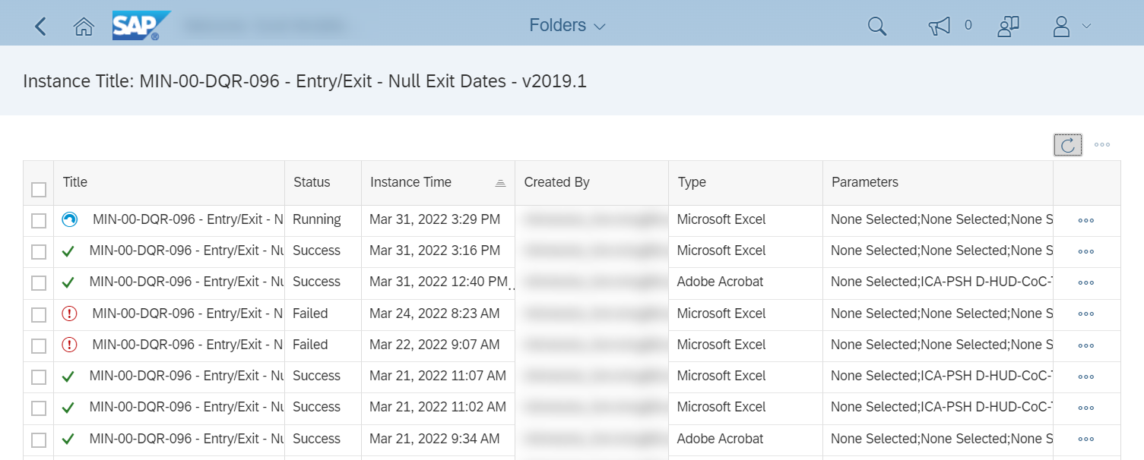
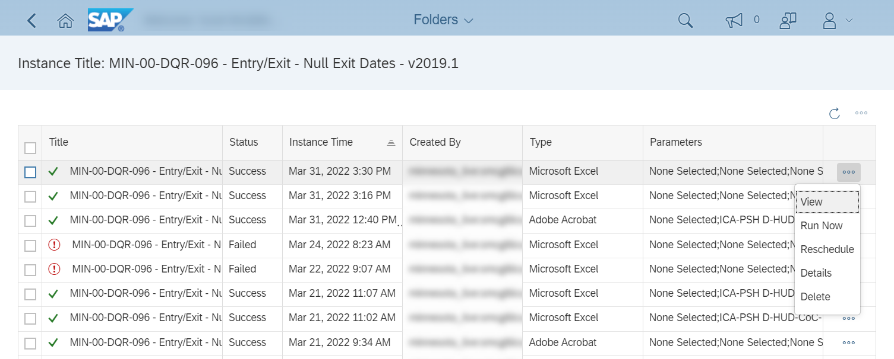
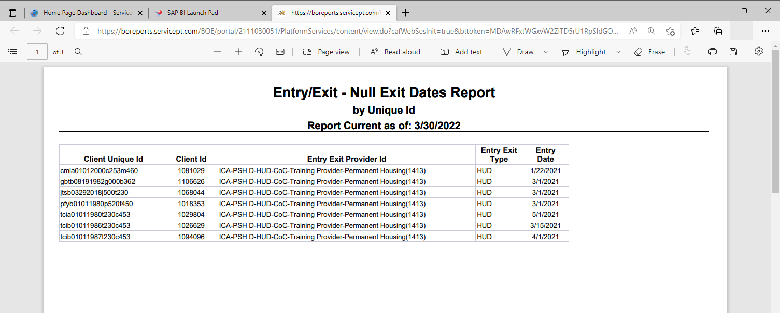
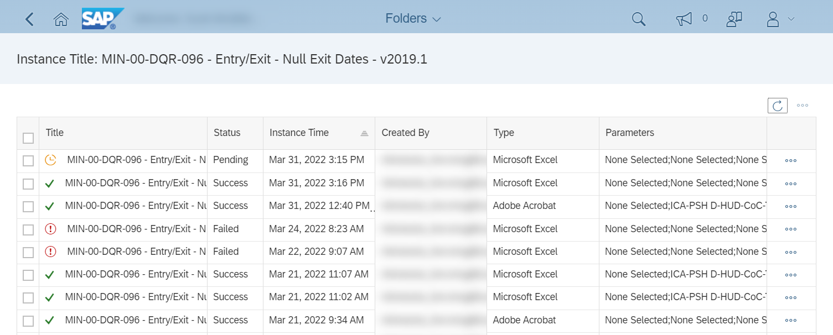
Running Reports: Post-Schedule Screen
C
D
A
B
When a report’s status has changed to Success, it can be downloaded by clicking on the name of the report (A) or selecting View from the actions menu (B).
PLEASE NOTE: Instead of being downloaded, PDF files will open in a new web browser tab (C) or PDF reader application. To keep copies of those files, you will need to save them (D).
After scheduling a report, you will be taken to a new screen that shows the report’s status. Previously scheduled copies of the same report may be displayed there as well.
As the report’s status changes, it will automatically be updated.
You can also check for updates manually by clicking on the refresh button.
Notes:
SCRIPT
After scheduling a report, you will be taken to a new screen that shows the report’s status. Previously scheduled copies of the same report may be displayed there as well.
[Click to Play Animation]
As the report’s status changes, it will automatically be updated.
[Click to Play Animation]
You can also check for updates manually by clicking on the refresh button.
[Click to Play Animation]
When a report’s status has changed to Success, it can be downloaded by clicking on the name of the report (A) or selecting View from the actions menu (B).
[Click to Play Animation]
PLEASE NOTE: Instead of being downloaded, PDF files will open in a new web browser tab (C) or PDF reader application. To keep copies of those files, you will need to save them (D).
[Click to Transition to Next Slide]

Slide 25
Running Reports:
Prompts
Notes:
SCRIPT
Prompts
[Click to Transition to Next Slide]

Slide 26
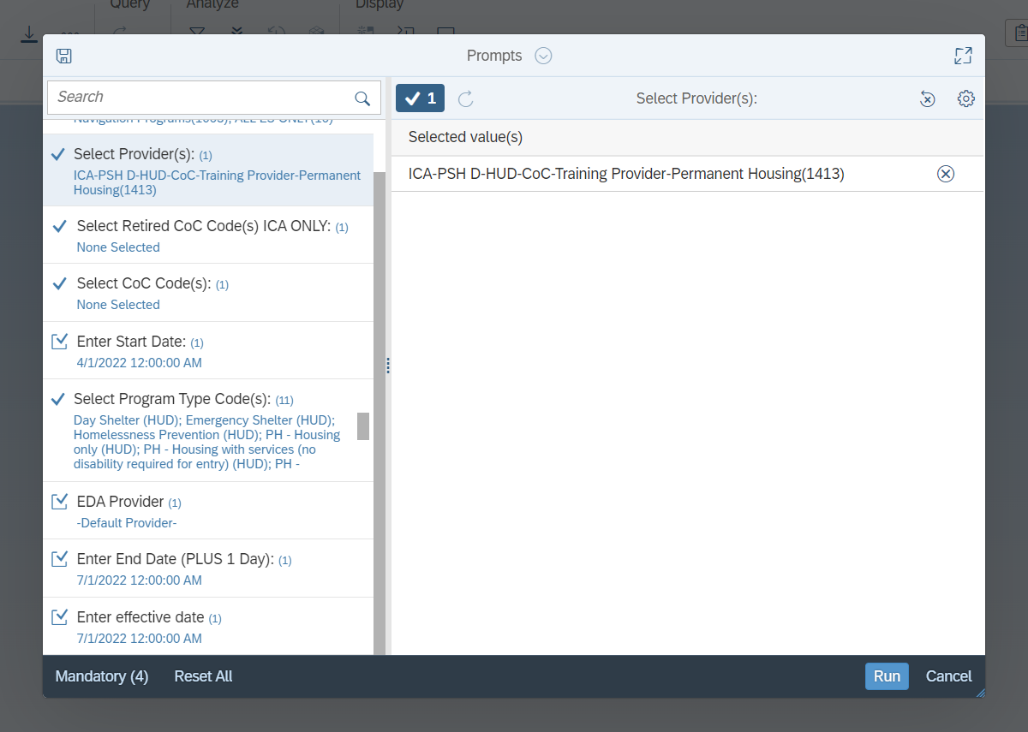
Running Reports: Prompts
The prompt values that you select when running a report will determine what data gets pulled into it.
Often, a report will be run using only these prompts:
Provider(s): Select one or more project providers.
Start Date: Select the first date of the reporting period.
End Date (PLUS 1 Day): Select the last date of the reporting period, plus one day.
Effective Date: Select the same date used for the End Date prompt.
Depending on the report, there may be additional prompts to complete.
Notes:
SCRIPT
The prompt values that you select when running a report will determine what data gets pulled into it.
[Click to Play Animation]
Often, a report will be run using only these prompts:
[Click to Play Animation]
Provider(s): Select one or more project providers.
[Click to Play Animation]
Start Date: Select the first date of the reporting period.
[Click to Play Animation]
End Date (PLUS 1 Day): Select the last date of the reporting period, plus one day.
[Click to Play Animation]
Effective Date: Select the same date used for the End Date prompt.
[Click to Play Animation]
Depending on the report, there may be additional prompts to complete.
[Click to Transition to Next Slide]

Slide 27
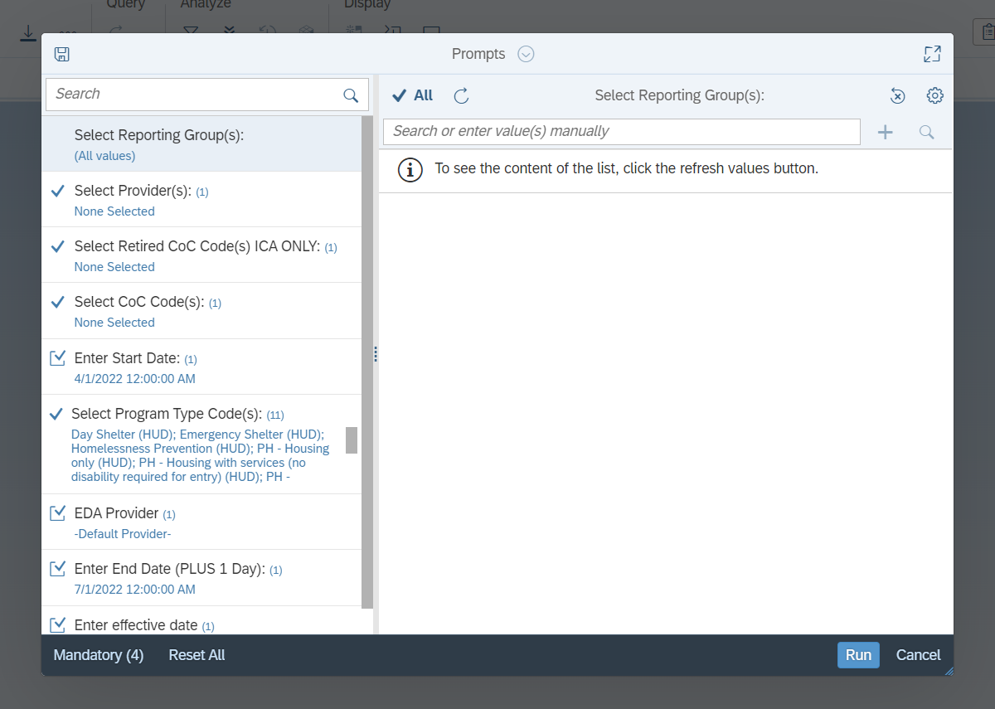
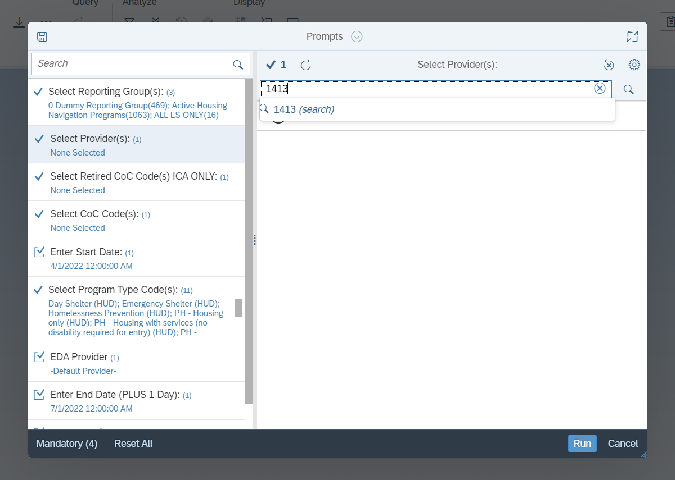
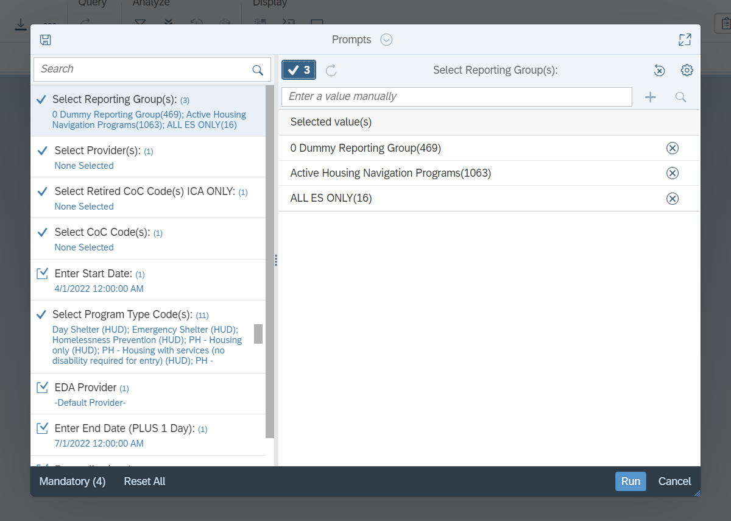
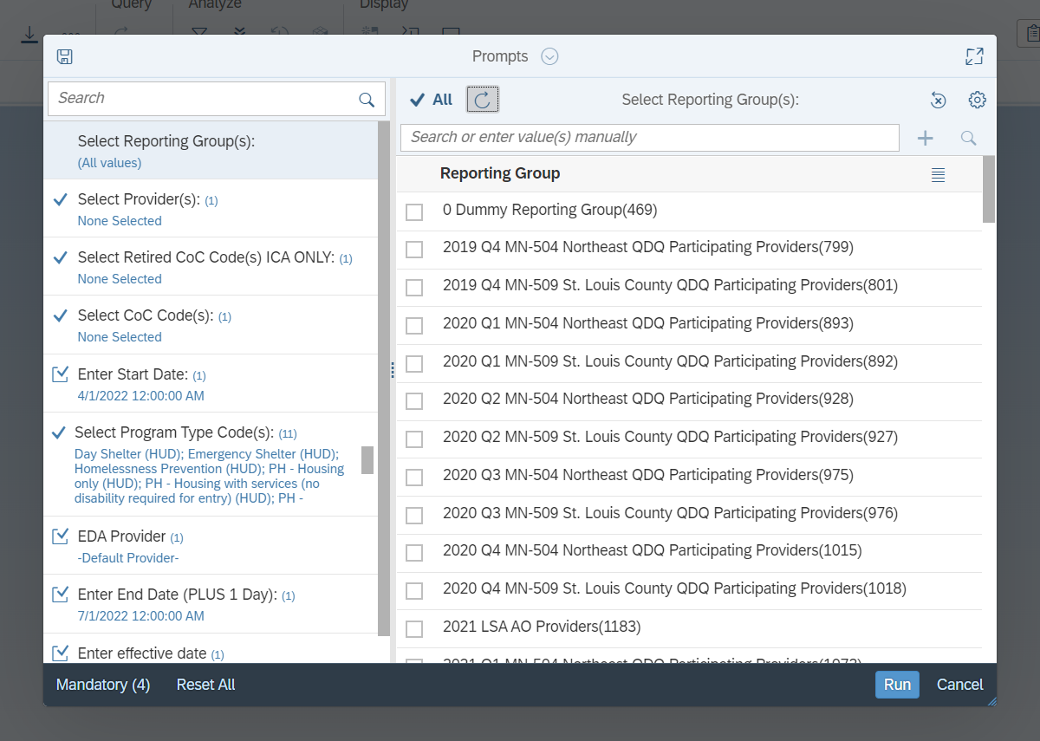
Running Reports: Filling Out Prompts
To specify which values you want to use in your report, select a prompt.
Click on the Refresh button to see a list of all available values.
Check the box next to a desired value to select it.
You can search for prompt values, as well.
To see which values have been selected, click on the Prompt Values button.
Choose the Reset Prompt or Reset All options when you want to clear selected values from prompts.
Notes:
SCRIPT
To specify which values you want to use in your report, select a prompt.
[Click to Play Animation]
Click on the Refresh button to see a list of all available values.
[Click to Play Animation]
Check the box next to a desired value to select it.
[Click to Play Animation]
You can search for prompt values, as well.
[Click to Play Animation]
To see which options have been selected, click on the Prompt Values button.
[Click to Play Animation]
Choose the Reset Prompt or Reset All options when you want to clear selected values from prompts.
[Click to Transition to Next Slide]

Slide 28
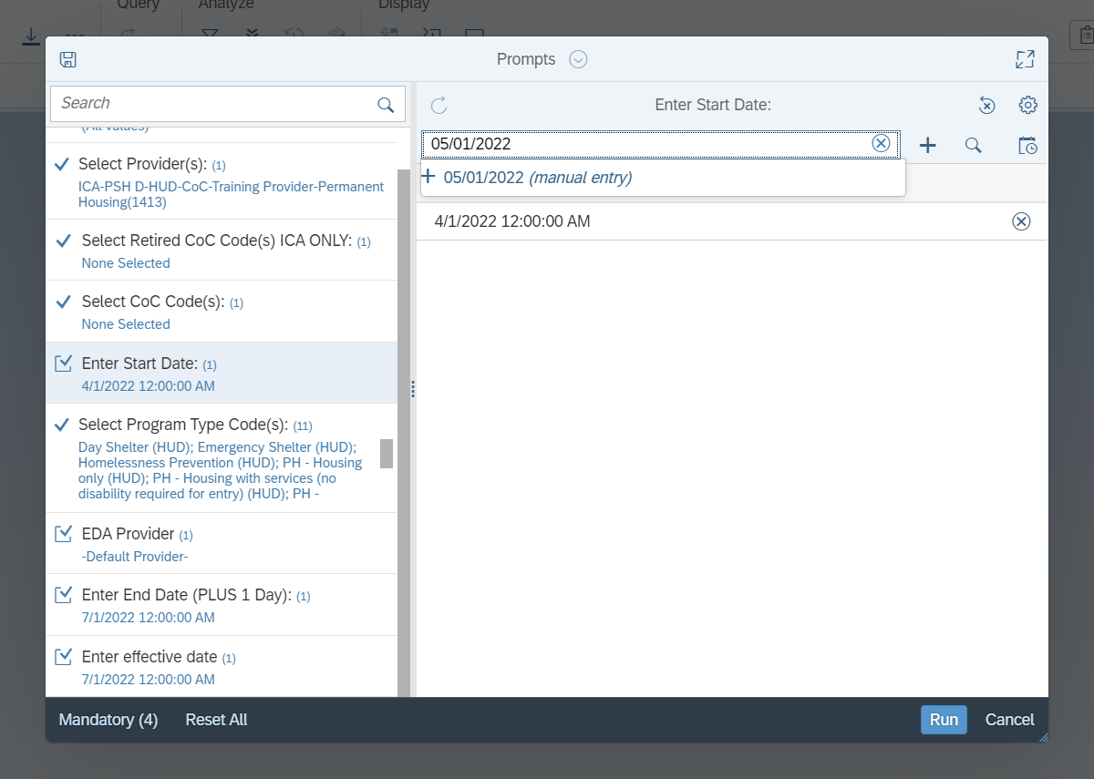
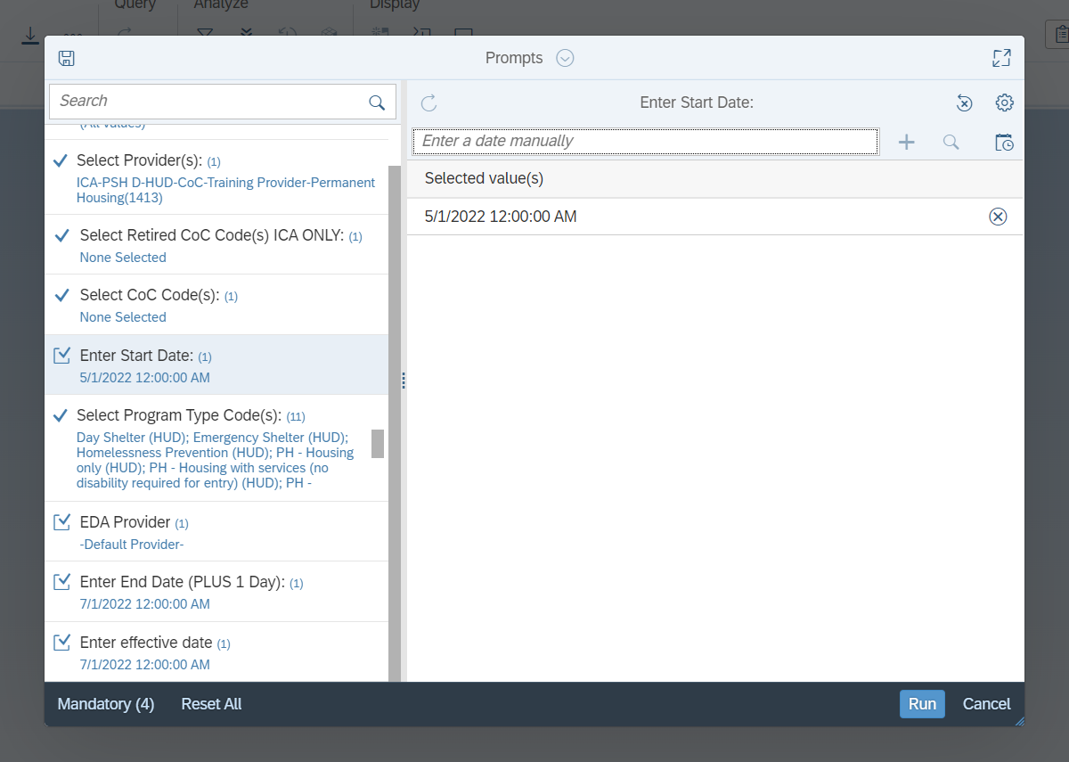
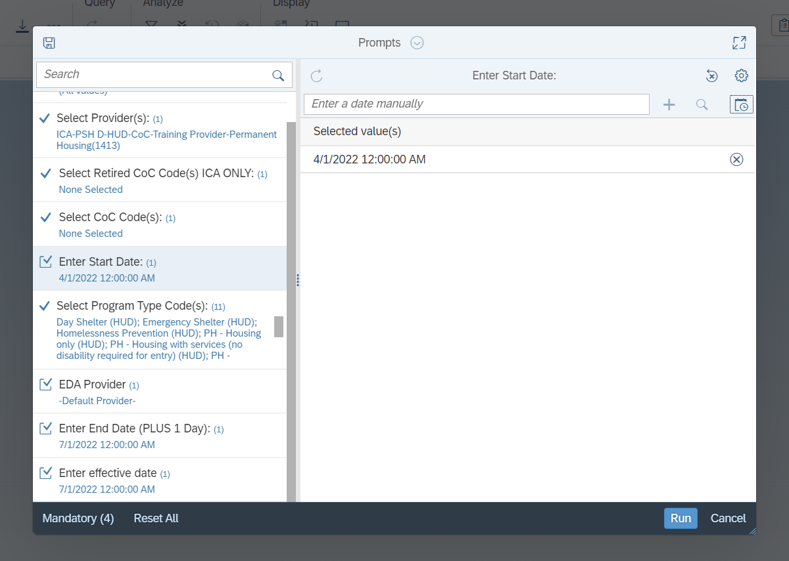
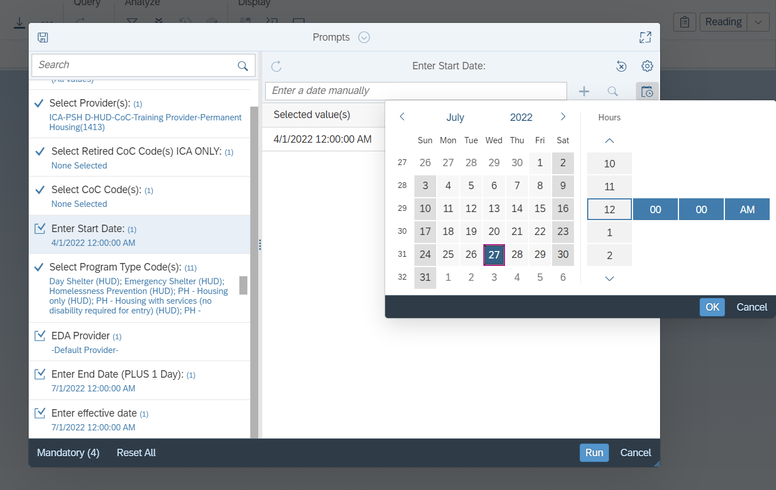
Running Reports: Date Prompts
There will always be at least one date prompt. Many reports feature three: Start Date, End Date, and Effective Date.
Click on the Calendar button to open a date selector popup.
ICA recommends using the default time (12:00:00 AM) in most cases.
Dates can be entered manually, too.
Only a single value can be selected for each date prompt.
A report’s End Date should always be the day after the last day of the reporting period.
The End Date and Effective Date prompts should have the same value.
Notes:
SCRIPT
There will always be at least one date prompt. Many reports feature three: Start Date, End Date, and Effective Date.
[Click to Play Animation]
Click on the Calendar button to open a date selector popup.
[Click to Play Animation]
ICA recommends using the default time (12:00:00 AM) in most cases.
[Click to Play Animation]
Dates can be entered manually, too.
[Click to Play Animation]
Only a single value can be selected for each date prompt.
[Click to Play Animation]
A report’s End Date should always be the day after the last day of the reporting period.
[Click to Play Animation]
The End Date and Effective Date prompts should have the same value.
[Click to Transition to Next Slide]

Slide 29
Finding Your Reports
Notes:
SCRIPT
Finding your reports.

Slide 30
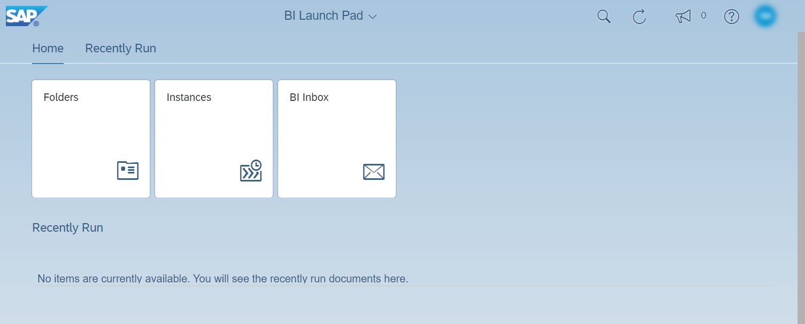
Finding Your Reports: Instances and the BI Inbox
Where can you find the reports you have scheduled?
By default, copies of reports we schedule will be saved in the Instances folder.
Optionally, we can choose to save copies of reports in the BI Inbox as well.
Notes:
SCRIPT
Where can you find the reports you have scheduled?
[Click to Play Animation]
By default, copies of reports we schedule will be saved in the Instances folder.
[Click to Play Animation]
Optionally, we can choose to save copies of reports in the BI Inbox as well.
[Click to Transition to Next Slide]

Slide 31
Finding Your Reports:
Instances
Notes:
SCRIPT
Let’s look at Instances first. “Instance” is a computer science term that means “copy”, so we can think of the Instances screen as the “report copies” screen.
[Click to Transition to Next Slide]

Slide 32
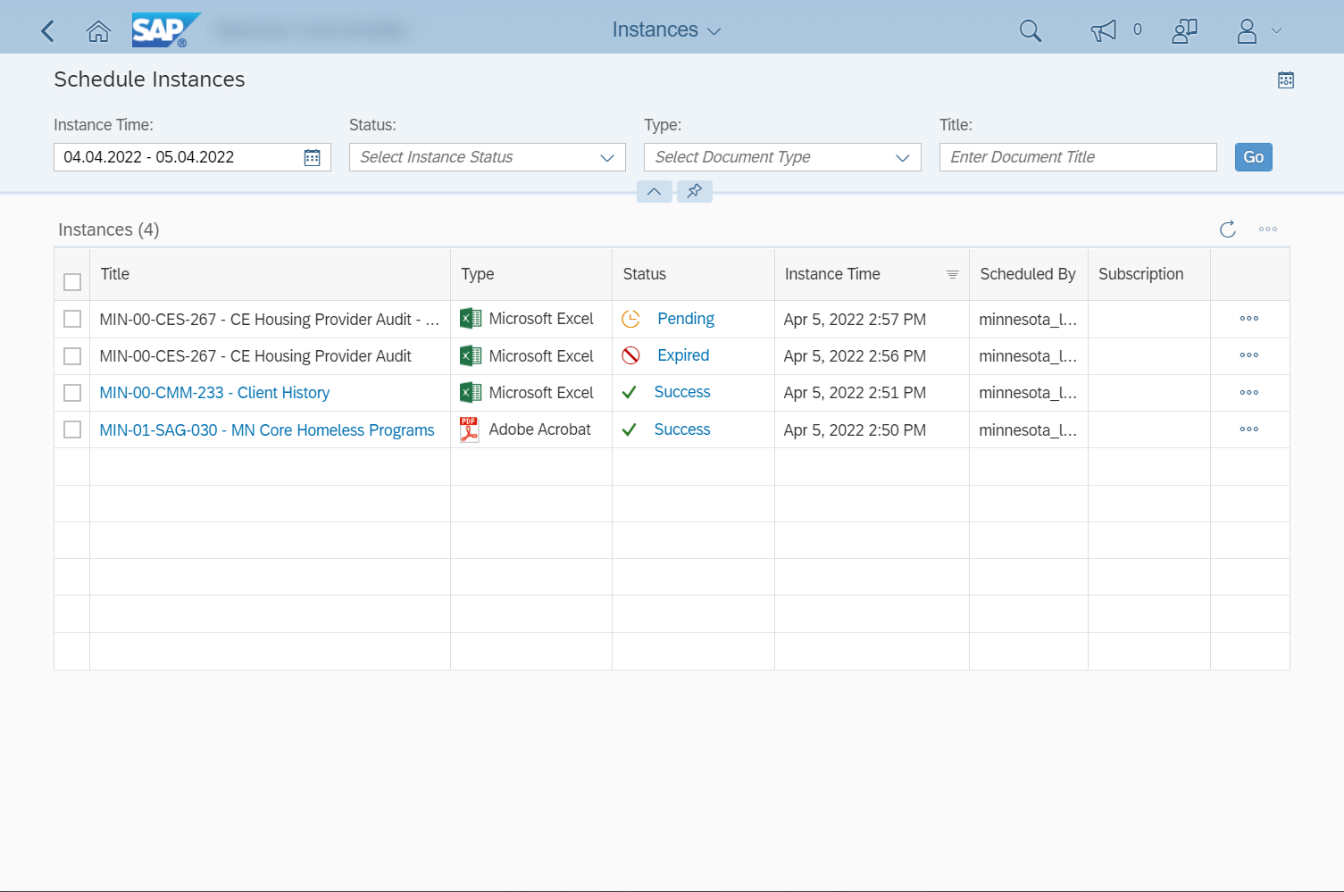
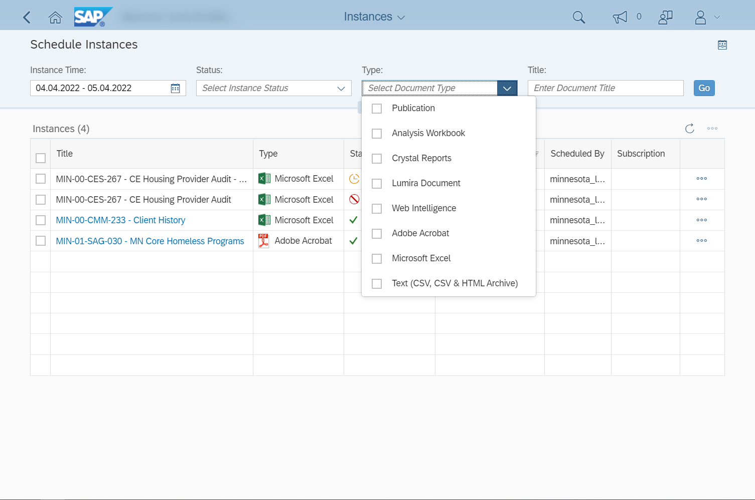
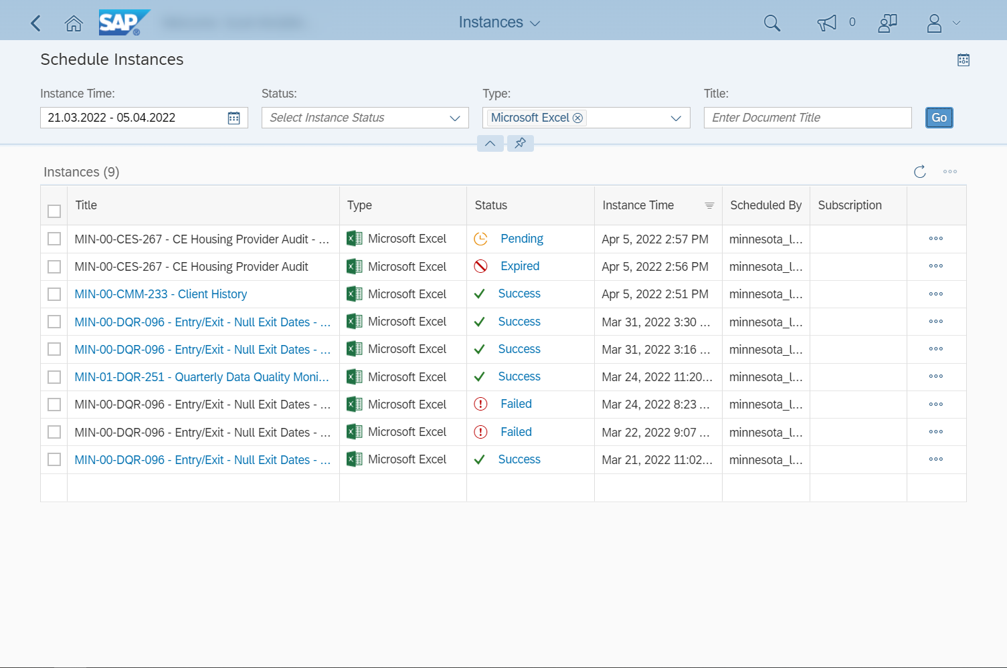
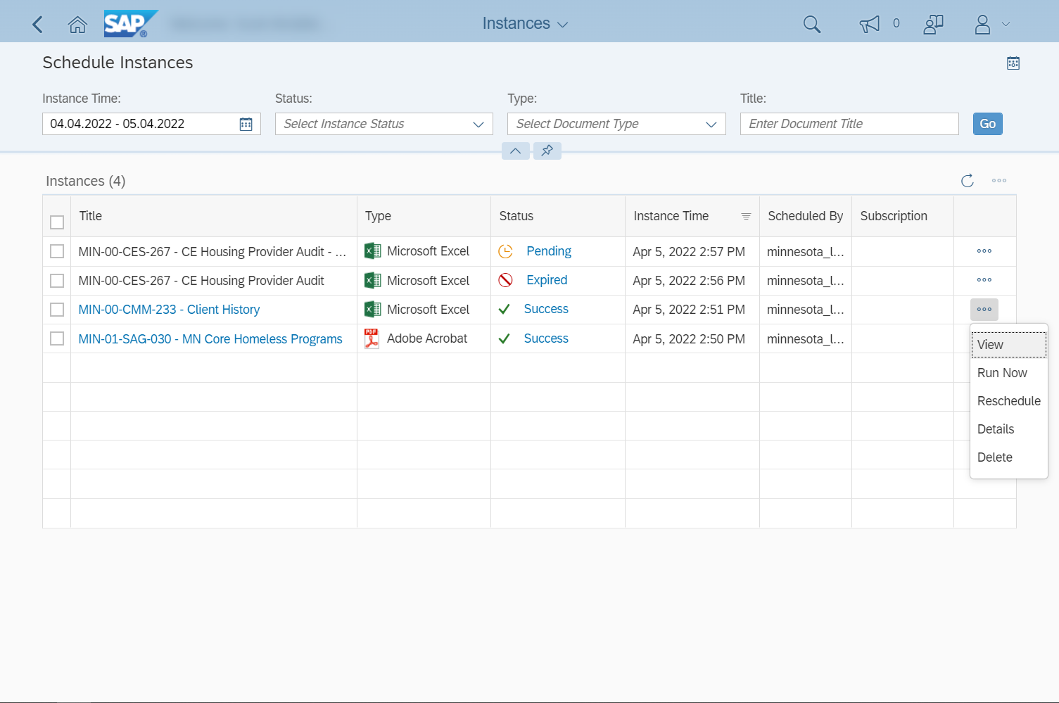
A
B
A
B
On the Instances screen, you will see reports that have finished running, are scheduled to run on a future date, or failed to complete.
To see status updates for reports that are currently running, you will need to either enable the Auto Refresh option (A) or click on the Refresh button (B) to manually check for updates.
By default, only reports scheduled within the last two days will be displayed. To see older reports, you will need to update the Instance Time.
Other filters can also be updated. For example, you could choose to search for Microsoft Excel files.
Clicking on Go will apply your filters, displaying any scheduled reports that match the search criteria.
A report with the status Success can be downloaded by clicking on its name (A) or selecting View from the actions menu (B). PDF files will open in a new web browser tab or PDF reader application and need to be saved from there.
In addition to downloading reports, you can also select the Run Now or Reschedule options to quickly re-run a previously scheduled report.
Selecting Details will display additional information about a report.
Unneeded reports can be manually deleted. Deleting a report from the Instances screen will not delete the same report from your BI Inbox.
Checking the box next to multiple reports lets you delete or re-run them together.
Notes:
SCRIPT
On the Instances screen, you will see reports that have finished running, are scheduled to run on a future date, or failed to complete.
[Click to Play Animation]
To see status updates for reports that are currently running, you will need to either enable the Auto Refresh option (A) or click on the Refresh button (B) to manually check for updates.
[Click to Play Animation]
By default, only reports scheduled within the last two days will be displayed. To see older reports, you will need to update the Instance Time.
[Click to Play Animation]
Other filters can also be updated. For example, you could choose to search for Microsoft Excel files.
[Click to Play Animation]
Clicking on Go will apply your filters, displaying any scheduled reports that match the search criteria.
[Click to Play Animation]
A report with the status Success can be downloaded by clicking on its name (A) or selecting View from the actions menu (B). PDF files will open in a new web browser tab or PDF reader application and need to be saved from there.
[Click to Play Animation]
In addition to downloading reports, you can also select the Run Now or Reschedule options to quickly re-run a previously scheduled report.
[Click to Play Animation]
Selecting Details will display additional information about a report.
[Click to Play Animation]
Unneeded reports can be manually deleted. Deleting a report from the Instances screen will not delete the same report from your BI Inbox.
[Click to Play Animation]
Checking the box next to multiple reports lets you delete or re-run them together.
[Click to Transition to Next Slide]

Slide 33
Finding Your Reports:
BI Inbox
Notes:
SCRIPT
Now, let’s take a peek at the BI Inbox.
[Click to Transition to Next Slide]

Slide 34
You can choose to send reports to your inbox when scheduling them. Unlike the Instances screen, only reports that have finished running will appear in your inbox.
The All tab and Documents tab will display the same list of saved reports. You can ignore the Alerts tab as that functionality is not used.
On the Documents tab, you can select multiple reports.
This is helpful when you need to delete more than one at a time. Deleting a report from your BI Inbox will not delete the same report from the Instances screen.
Selecting View will automatically download Excel files. PDF files will open in a new web browser tab or PDF reader application and will need to be saved separately.
You may also want to mark a report as unread to show that you have not reviewed it yet.
Notes:
SCRIPT
You can choose to send reports to your inbox when scheduling them. Unlike the Instances screen, only reports that have finished running will appear in your inbox.
[Click to Play Animation]
The All tab and Documents tab will display the same list of saved reports. You can ignore the Alerts tab as that functionality is not used.
[Click to Play Animation]
On the Documents tab, you can select multiple reports.
[Click to Play Animation]
This is helpful when you need to delete more than one at a time. Deleting a report from your BI Inbox will not delete the same report from the Instances screen.
[Click to Play Animation]
Selecting View will automatically download Excel files. PDF files will open in a new web browser tab or PDF reader application and will need to be saved separately.
[Click to Play Animation]
You may also want to mark a report as unread to show that you have not reviewed it yet.
[Click to Transition to Next Slide]

Slide 35
Finding Your Reports: Recently Run
The Recently Run section of the home screen is another place you can download scheduled reports, view their details, and delete them. Deleting a report from the Recently Run section will remove it from the Instances folder but will not delete a copy saved in your BI Inbox.
Clicking on View All Recently Run will bring up a more comprehensive list of completed scheduled reports.
Notes:
SCRIPT
The Recently Run section of the home screen is another place you can download scheduled reports, view their details, and delete them. Deleting a report from the Recently Run section will remove it from the Instances folder but will not delete a copy saved in your BI Inbox.
[Click to Play Animation]
Clicking on View All Recently Run will bring up a more comprehensive list of completed scheduled reports.
[Click to Transition to Next Slide]

Slide 36
Automatic Deletion of Reports
Instances
BI INbox
60 days
365 Days / 1 year
Reports saved in your Instances folder will be automatically deleted after 60 days; reports in your BI Inbox, however, can be kept for up to a year (365 days).
If a report needs to be preserved for a longer period of time than BusinessObjects allows, it should be saved in a secure location outside of the reporting tool.
Notes:
SCRIPT
Reports saved in your Instances folder will be automatically deleted after 60 days; reports in your BI Inbox, however, can be kept for up to a year (365 days).
[Click to Play Animation]
If a report needs to be preserved for a longer period of time than BusinessObjects allows, it should be saved in a secure location outside of the reporting tool.
[Click to Transition to Next Slide]

Slide 37
Additional Information
Notes:
SCRIPT
Additional information.
[Click to Transition to Next Slide]

Slide 38
Timing Out
Timing out of BusinessObjects will not log you out of HMIS. The reverse is true as well: If you log out of HMIS, it will not affect your work in the reporting tool.
BusinessObjects will automatically log you out after 25 minutes of inactivity. This security measure is referred to as “timing out”.
A Session Timeout Warning popup will appear when there are five minutes of inactivity remaining. Clicking on Continue will reset the timer to 25 minutes.
When the timeout limit is reached, you will see a Session Expired popup. Clicking on OK will take you a login screen.
Entering your credentials on the Log in to BI Launch Pad screen will not restart BusinessObjects. Instead, you will need to reopen the tool from HMIS.
Notes:
SCRIPT
BusinessObjects will automatically log you out after 25 minutes of inactivity. This security measure is referred to as “timing out”.
[Click to Play Animation]
A Session Timeout Warning popup will appear when there are five minutes of inactivity remaining. Clicking on Continue will reset the timer to 25 minutes.
[Click to Play Animation]
When the timeout limit is reached, you will see a Session Expired popup. Clicking on OK will take you a login screen.
[Click to Play Animation]
Entering your credentials on the Log in to BI Launch Pad screen will not restart BusinessObjects. Instead, you will need to reopen the tool from HMIS.
[Click to Play Animation]
Timing out of BusinessObjects will not log you out of HMIS. The reverse is true as well: If you log out of HMIS, it will not affect your work in the reporting tool.
[Click to Transition to Next Slide]

Slide 39
Data Warehouse Build / Refresh
Folders
User Settings
10 AM DATA
6 AM DATA
6 AM DATA
6 AM DATA
HMIS
BusinessObjects
Report
8 AM Refresh?
12 PM Refresh?
The reporting tool copies data from HMIS twice a day. These data transfers are referred to as the “warehouse build” or “refresh”. When you run a report, only data that has been copied from HMIS is available to pull into that report.
To see when the last warehouse build was completed, you can check two different places:
Folders: Find the minnesota_live_folder and check the timestamp in the Last Updated column.
User Settings: On the User Account screen, check the timestamp in the Password Last Changed field. There may be a slight difference between the two reported times, as you can see in this example.
Notes:
SCRIPT
The reporting tool copies data from HMIS twice a day. These data transfers are referred to as the “warehouse build” or “refresh”. When you run a report, only data that has been copied from HMIS is available to pull into that report.
[Click to Play Animation]
To see when the last warehouse build was completed, you can check two different places:
[Click to Play Animation]
Folders: Find the minnesota_live_folder and check the timestamp in the Last Updated column.
[Click to Play Animation]
User Settings: On the User Account screen, check the timestamp in the Password Last Changed field.
There may be a slight difference between the two reported times, as you can see in this example.
[Click to Transition to Next Slide]

Slide 40
Web Intelligence
The Web Intelligence application is used to update existing reports and build new ones. While you may see a link to this tool displayed on your home screen, that link will only work for users with an Adhoc Reporting license.
Notes:
SCRIPT
The Web Intelligence application is used to update existing reports and build new ones. While you may see a link to this tool displayed on your home screen, that link will only work for users with an Adhoc Reporting license.
[Click to Transition to Next Slide]

Slide 41
Have a Question About a Report?
Hello Helpdesk,
I am having trouble with the MIN-01-SAG-030 - MN Core Homeless Programs report that I ran for provider #1413. The date range is Jan 1, 2022 – Dec 31, 2022.
See client ID #176429 for an example.
Contact the HMIS Helpdesk at mnhmis@icalliances.org and we will be happy to assist you.
To ensure we can offer the best possible support, we recommend the following:
Schedule the report, using the Microsoft Excel file format.
Include the report’s name and prompt values in your email.
Share any client ID numbers of interest.
If you choose to attach a copy of the report or include any screenshots, please remove any Personally Identifiable Information (PII) like client names or Social Security Numbers first!
Notes:
SCRIPT
Have a question about a report? Contact the HMIS Helpdesk at mnhmis@icalliances.org and we will be happy to assist you.
[Click to Play Animation]
To ensure we can offer the best possible support, we recommend the following:
[Click to Play Animation]
Schedule the report, using the Microsoft Excel file format.
[Click to Play Animation]
Include the report’s name and prompt values in your email.
[Click to Play Animation]
Share any client ID numbers of interest.
[Click to Play Animation]
If you choose to attach a copy of the report or include any screenshots, please remove any Personally Identifiable Information (PII) like client names or Social Security Numbers first!
[Click to Transition to Next Slide]

Slide 42
Thanks for Watching!
Questions? Comments?
Contact us at mnhmis@icalliances.org
Notes:
SCRIPT
Thank you for watching! Please send any questions or comments to mnhmis@icalliances.org.
[Click to End Slideshow]

